Slide 1
Getting Ready for i-Ready
2020-2021

Slide 2
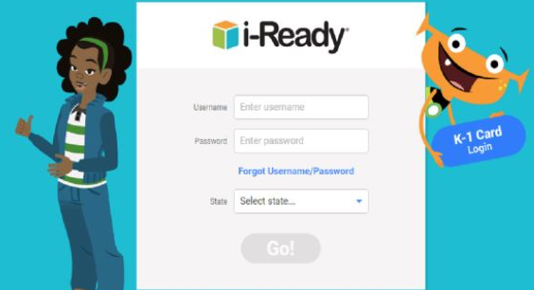
Log -ins
The 2020-2021 i-Ready Usernames are the same as last year.
You can find your i-Ready account.
All student passwords are gnets
Email me if you have forgotten your password or username.

Slide 3
i-Ready Expectations
45 minutes a week (M-F)
In both Reading & Math
70% Pass Rate

Slide 4
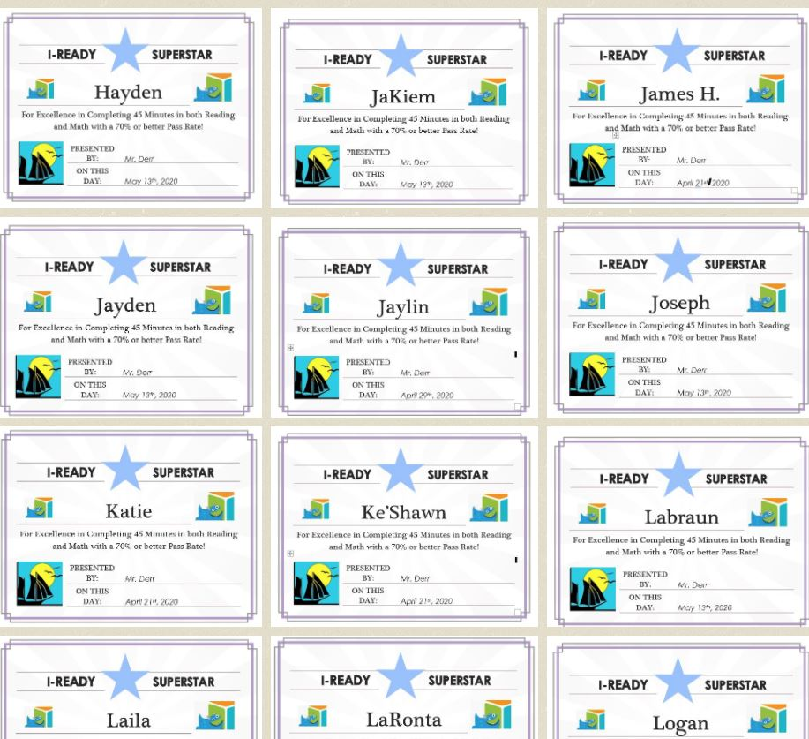
Superstars!

Slide 5
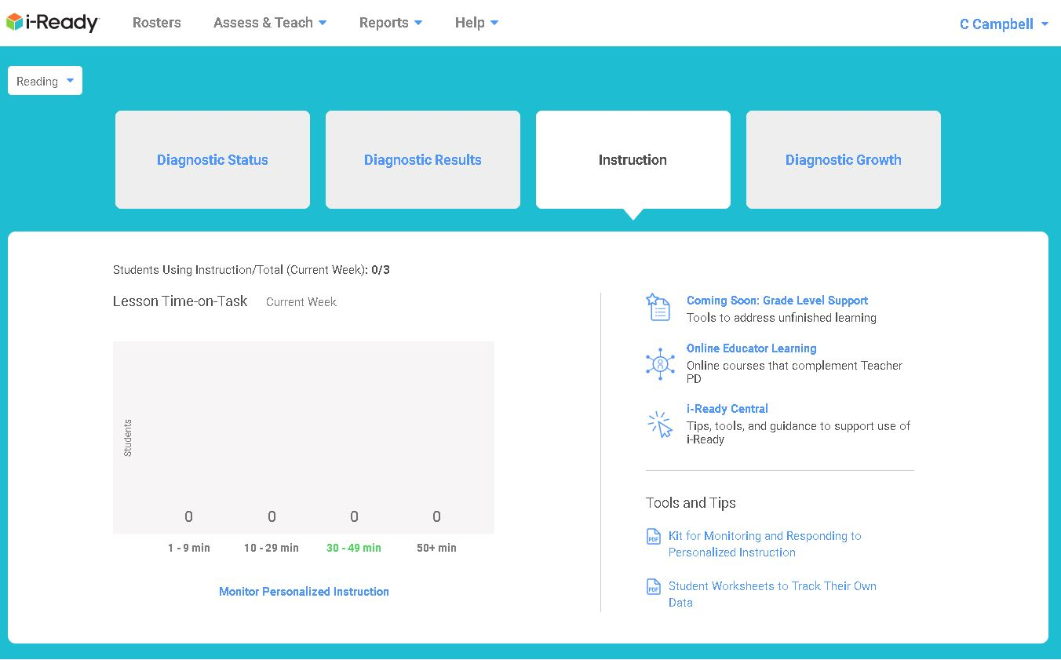
Teacher Dashboard

Slide 6
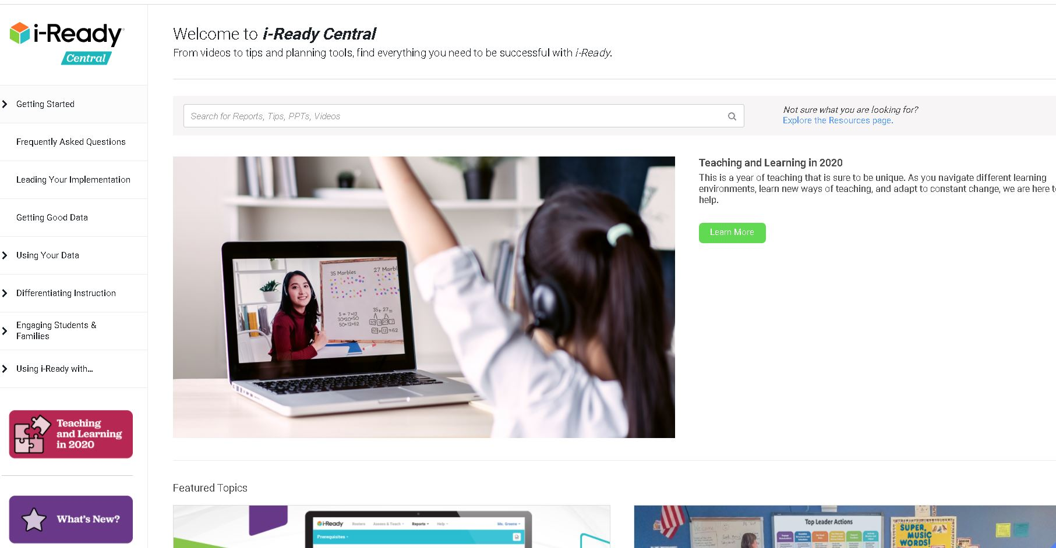

Slide 7
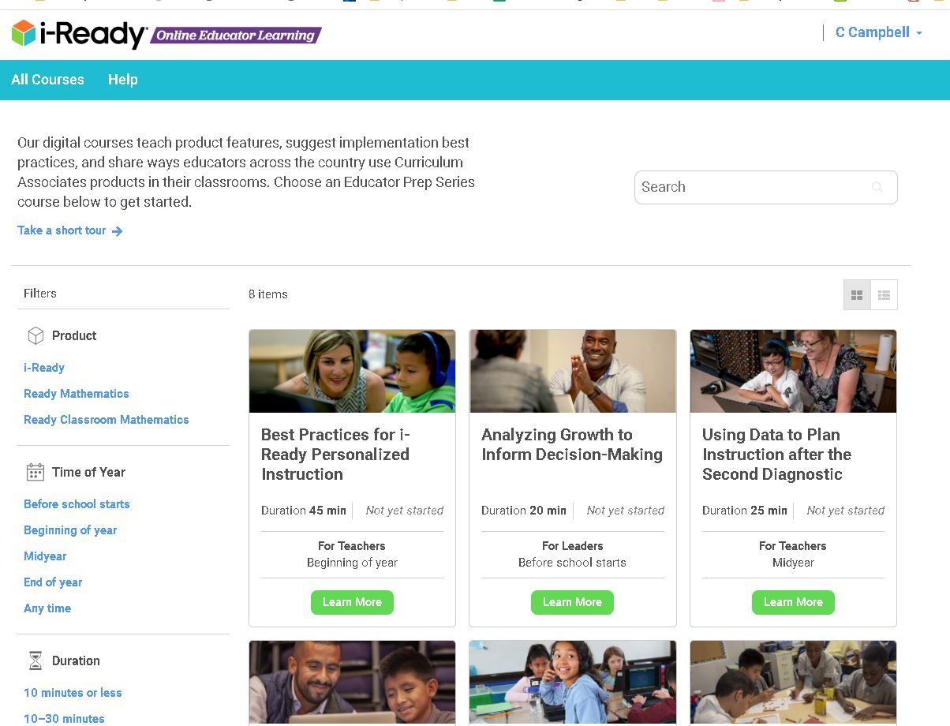
Teacher Tools

Slide 8
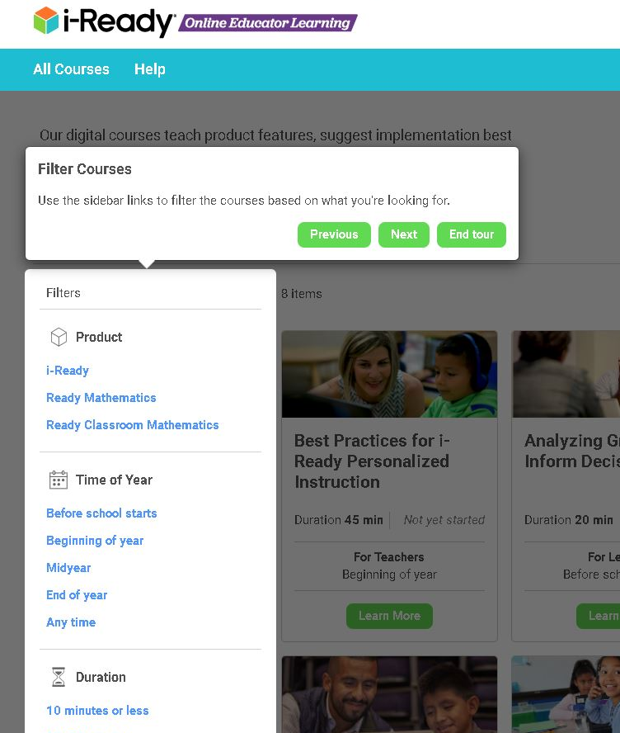
Take the tour!

Slide 9
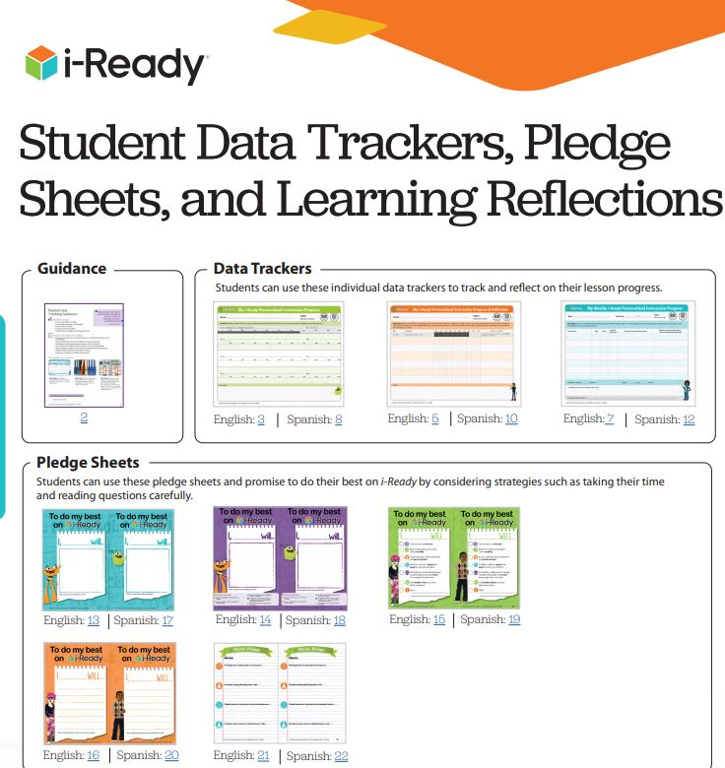
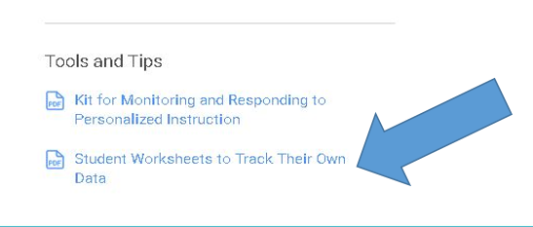

Slide 10
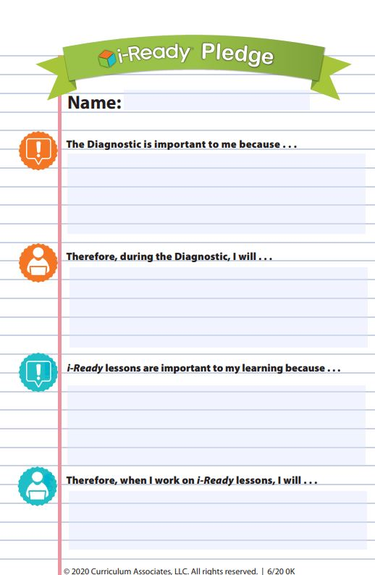
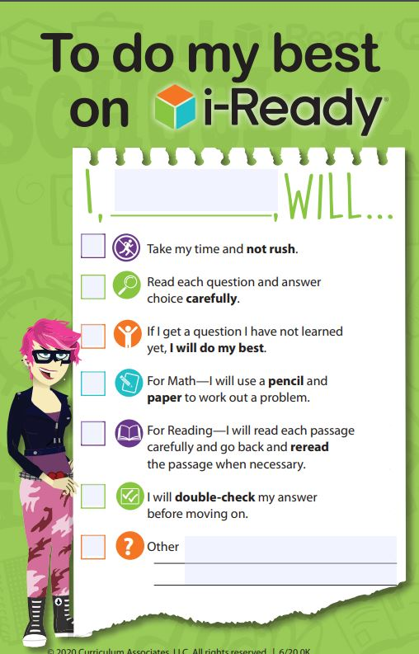
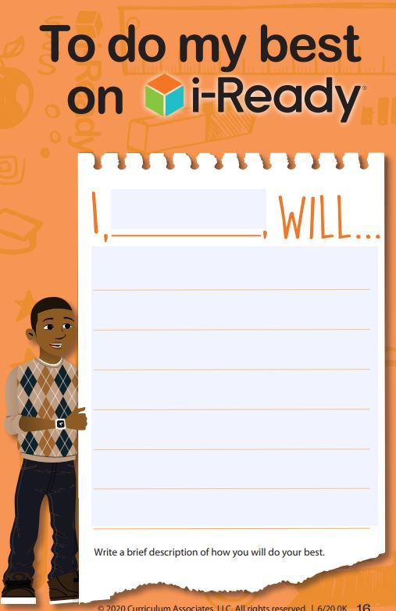

Slide 11
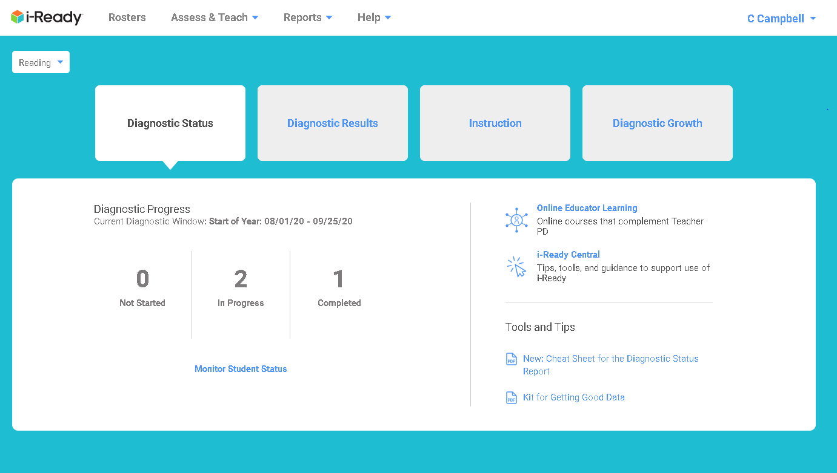
New Dashboard info for each section

Slide 12
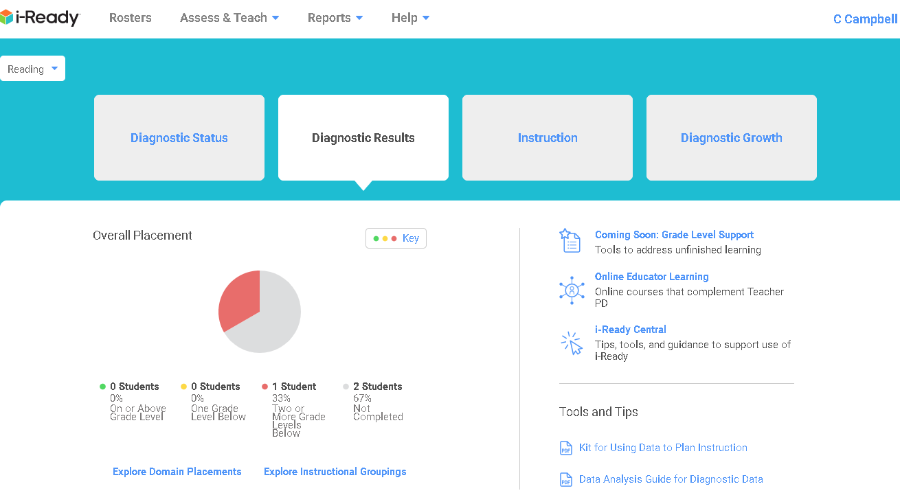

Slide 13
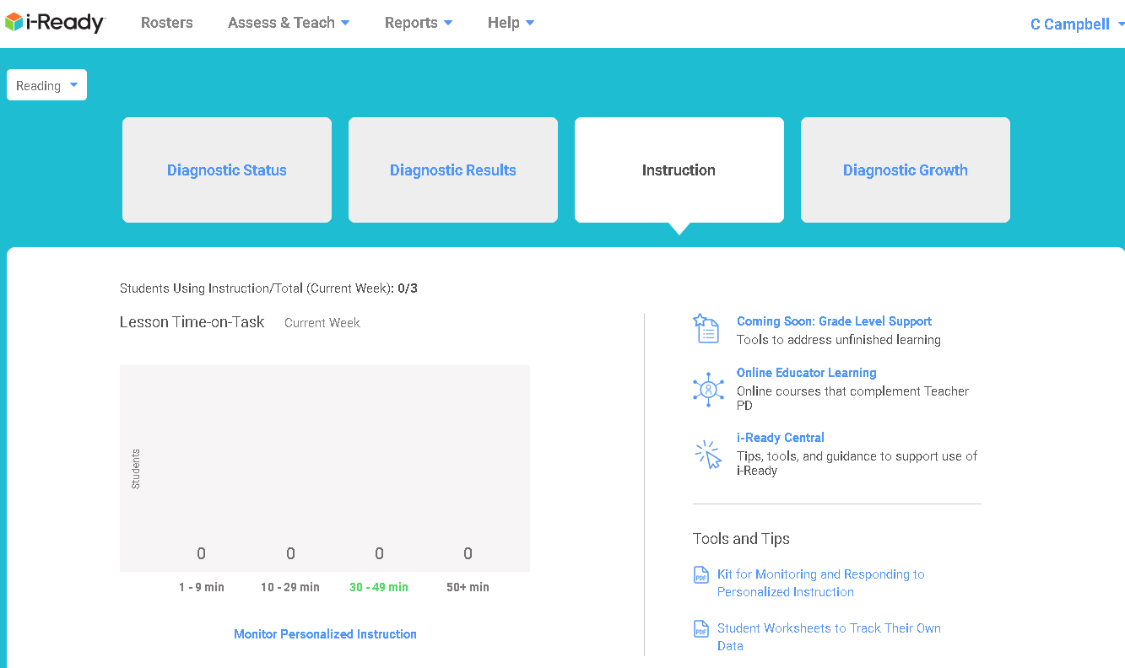

Slide 14
The Diagnostic
Encourage Good Testing Behavior
Read carefully
Take your time
Don’t get discouraged

Slide 15
The Diagnostic
Work with parents to make it a success.

Slide 16
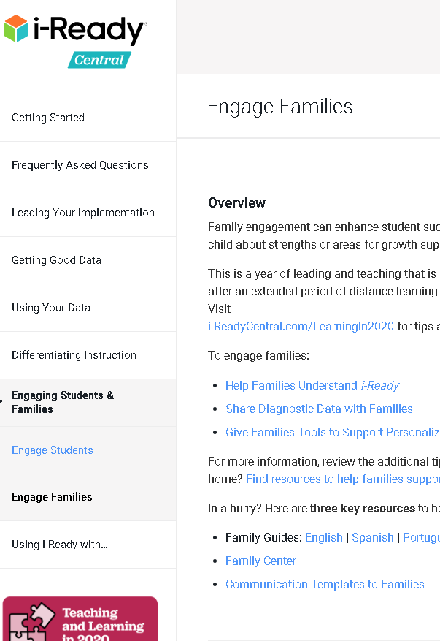

Slide 17
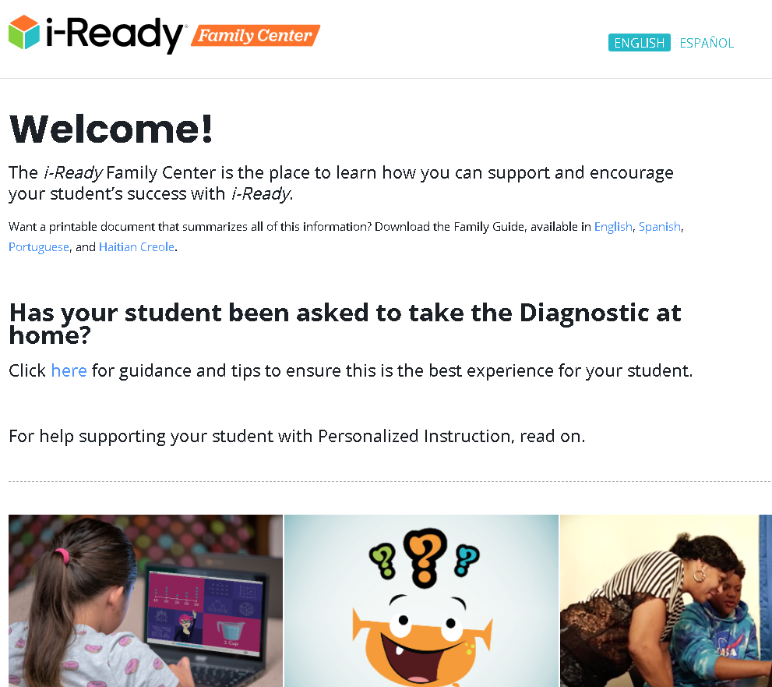

Slide 18
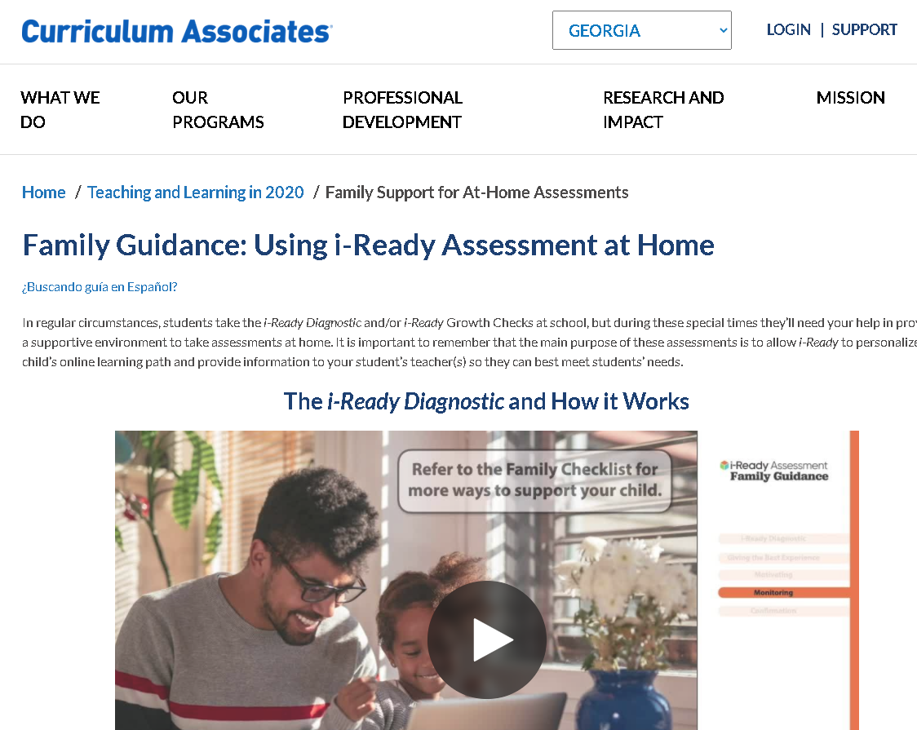

Slide 19
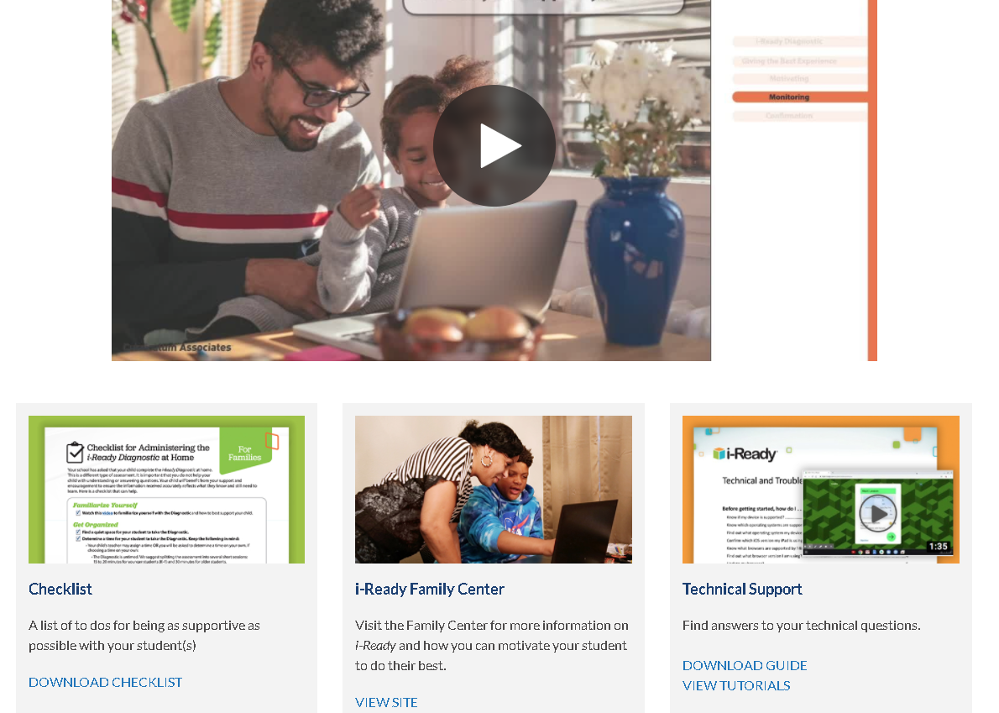

Slide 20
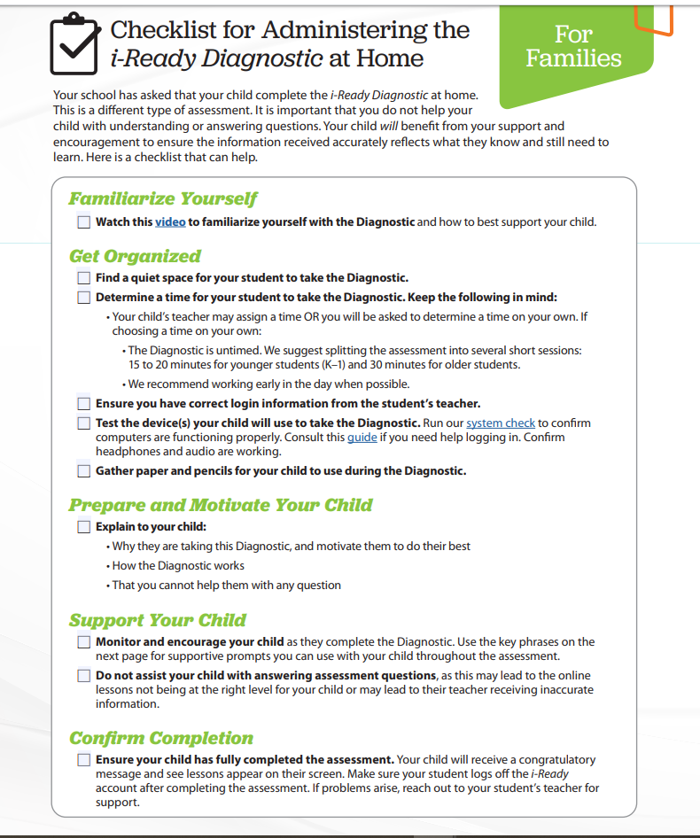
Uploaded to Files of this meeting and to the files of CGCA Team.

Slide 22
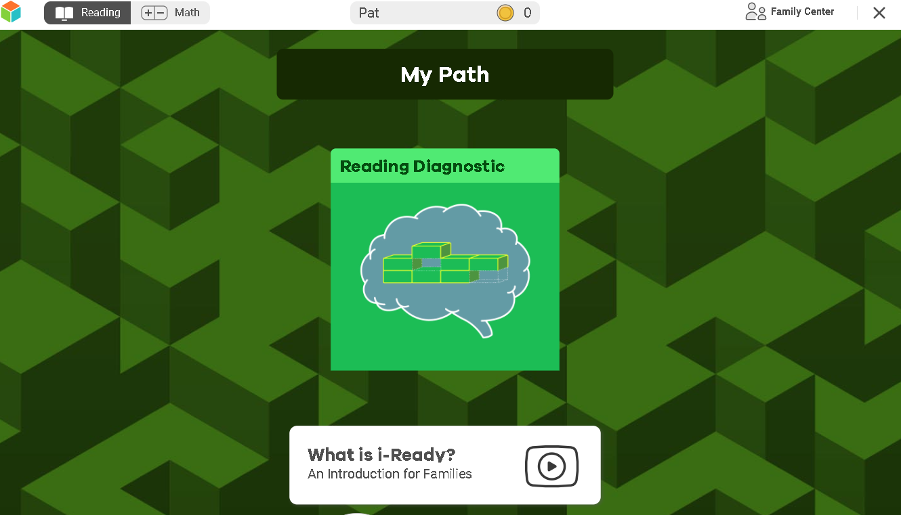

Slide 23
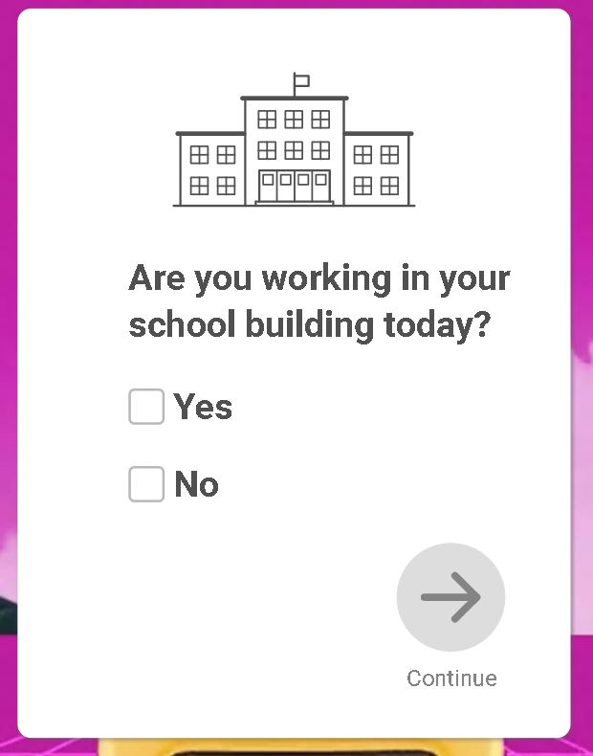
Choose YES and the student goes straight to the diagnostic.
Choose NO and the student goes to a Getting started Video.

Slide 25
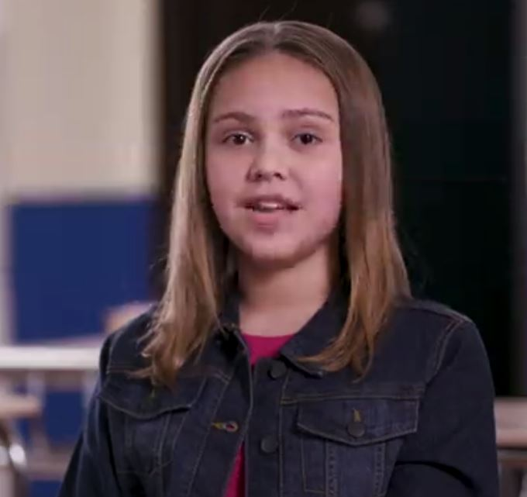
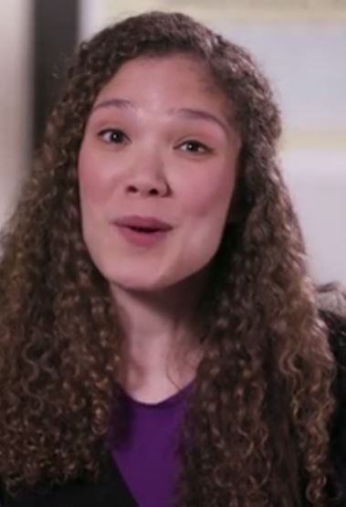
Your Video Hosts

Slide 26
Turn on captions
by clicking on the CC

Slide 28
Expect to answer only
½ the questions correctly!

Slide 29
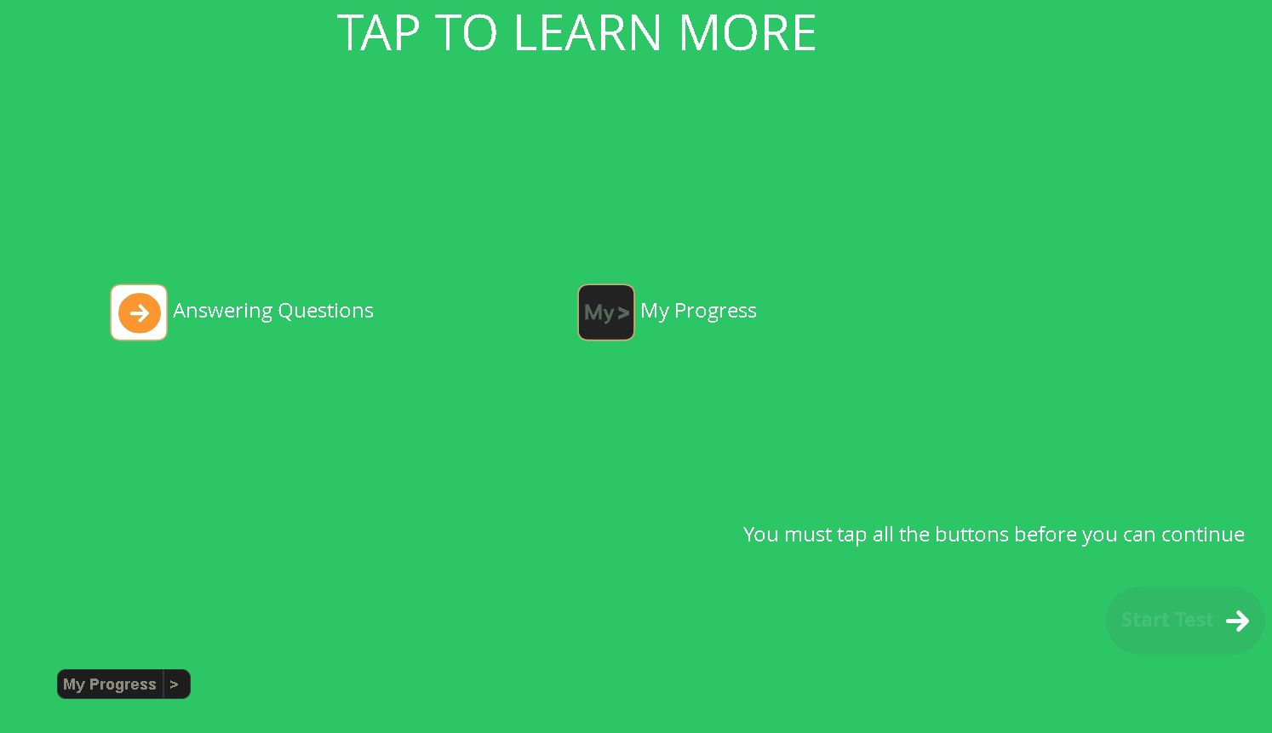
Students must click on the two buttons.

Slide 30
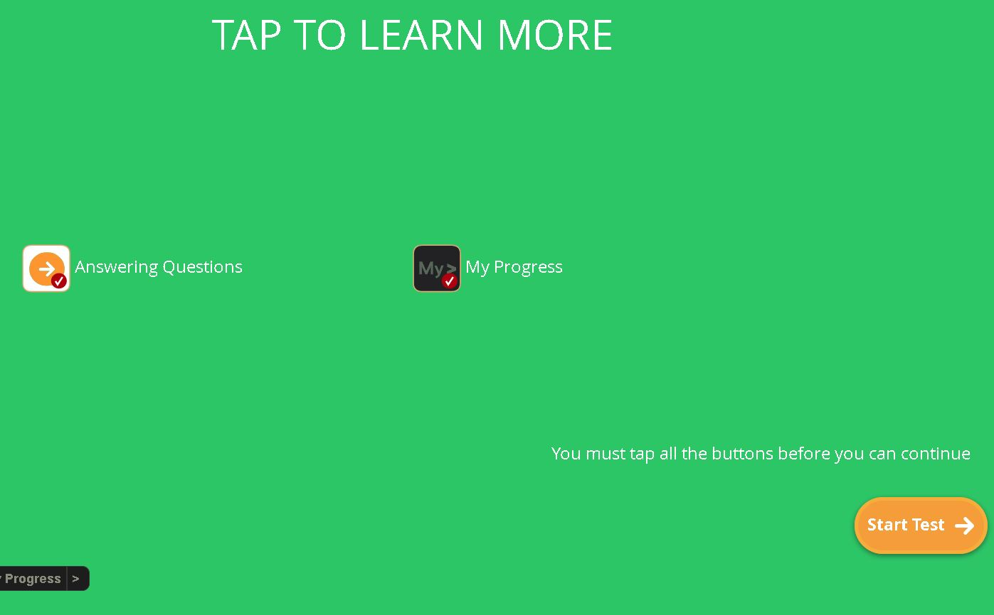

Slide 31
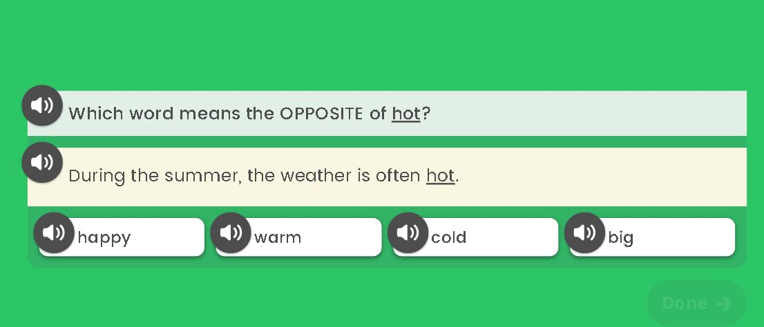
In early grades, the Read-Aloud feature begins at the start of the diagnostic.
In upper grades, the Read-Aloud feature starts when the student answers several questions incorrectly.

Slide 33
More tips during diagnostic

Slide 35
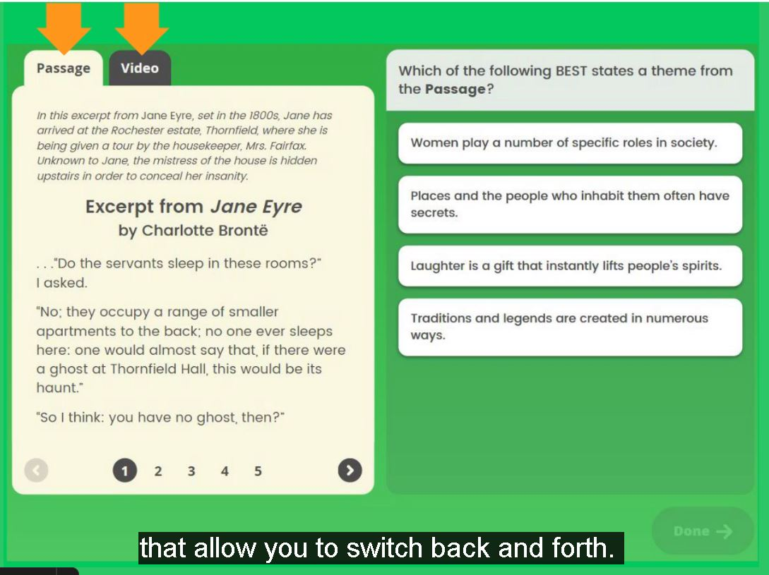

Slide 36
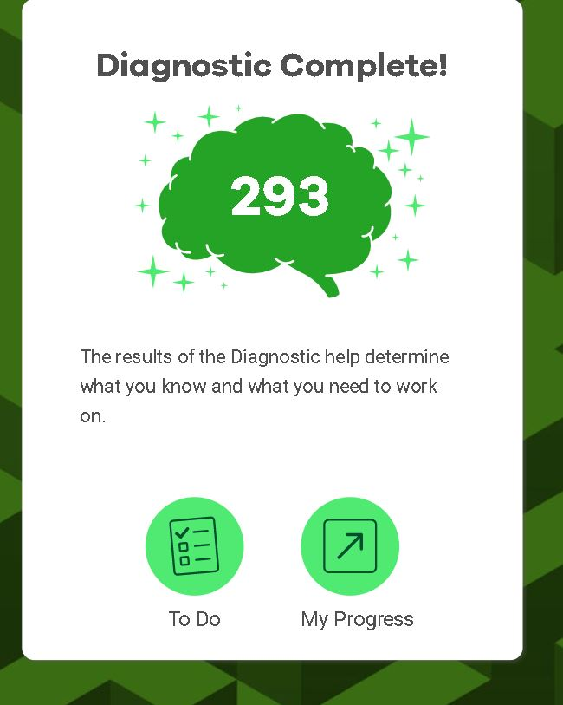
Remember:
Students do not have to finish diagnostic at one sitting!
It will start them where they left off!

Slide 37
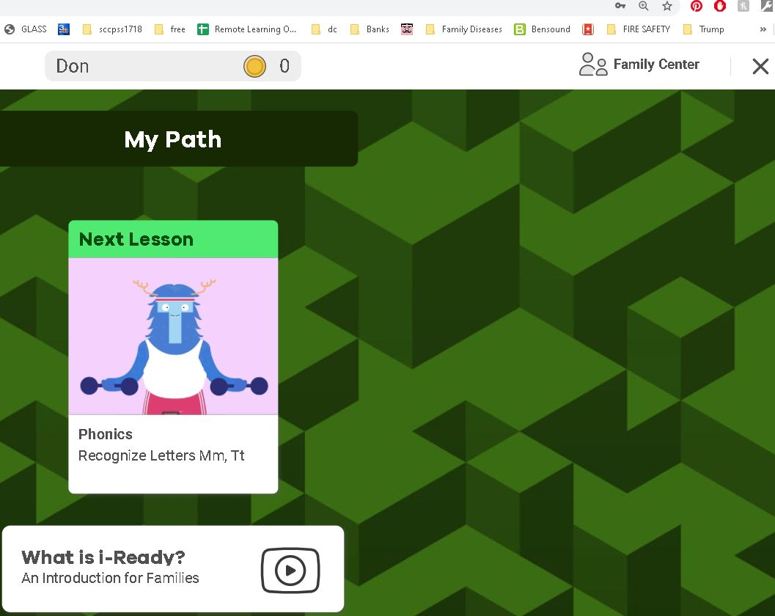

Slide 38
Questions?

