Slide 1
Getting Ready for i-Ready
2022-2023

Slide 2
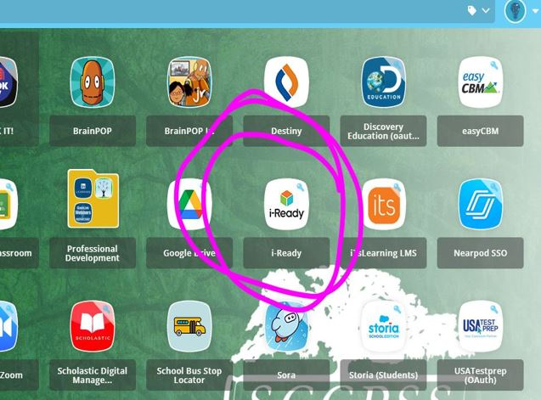
Log -ins
Students will log-in to i-Ready using Classlink!
You can find your i-Ready account there, too!

Slide 3
i-Ready Expectations
45 minutes a week (M-F)
In both Reading & Math
70% Pass Rate

Slide 4
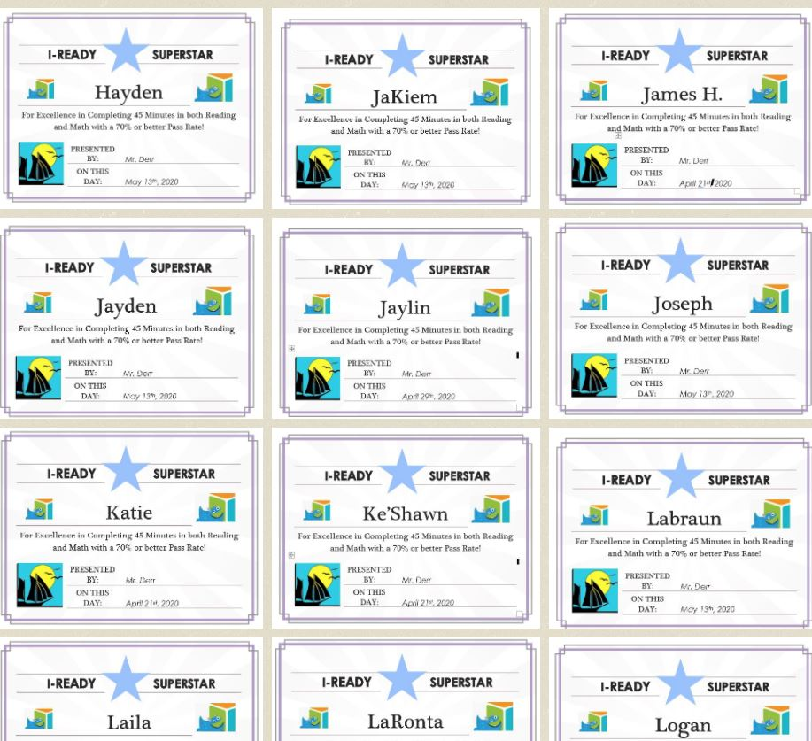
Superstars!

Slide 5
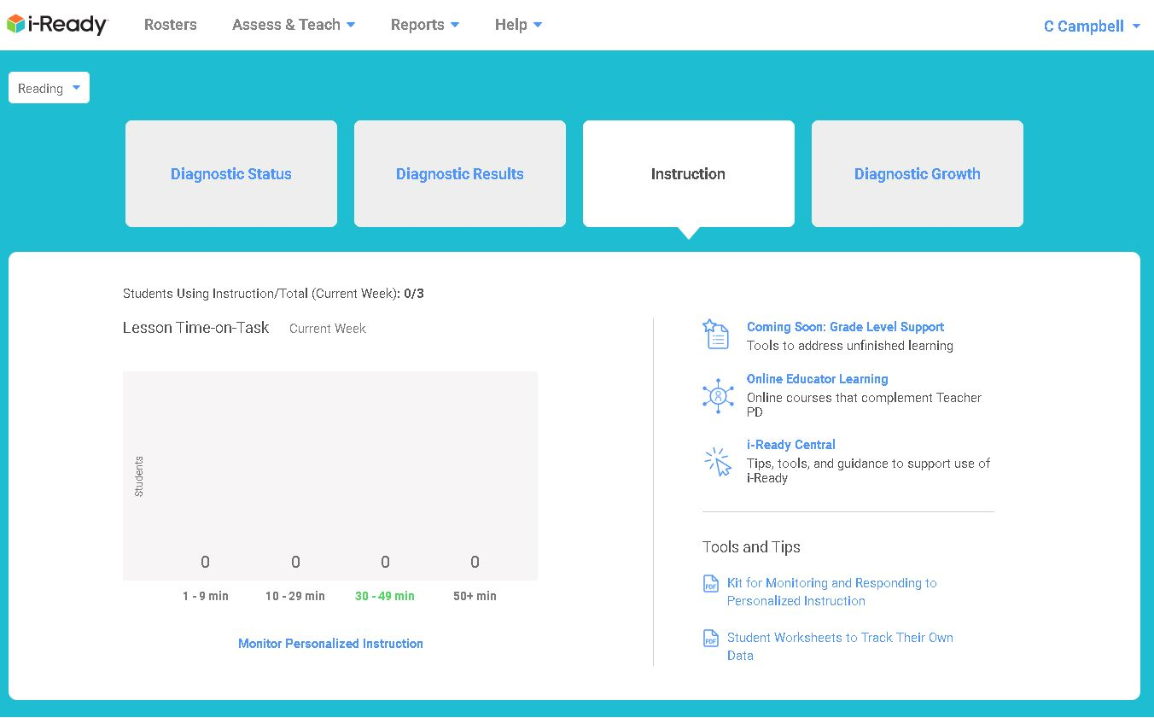
Teacher Dashboard

Slide 6
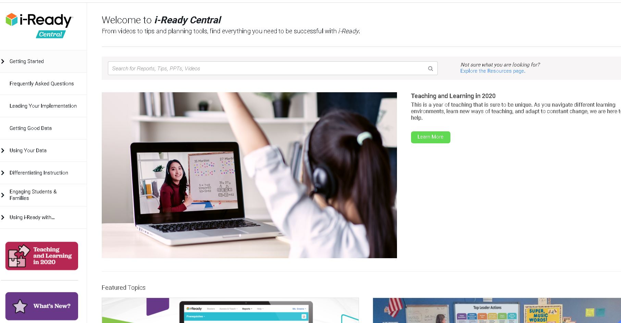

Slide 7
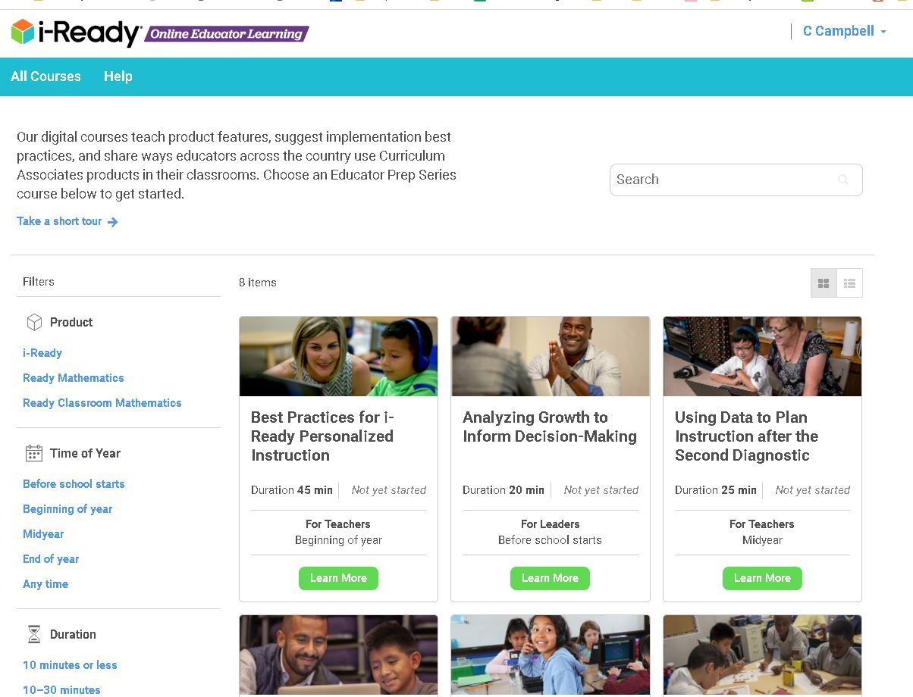
Teacher Tools

Slide 8
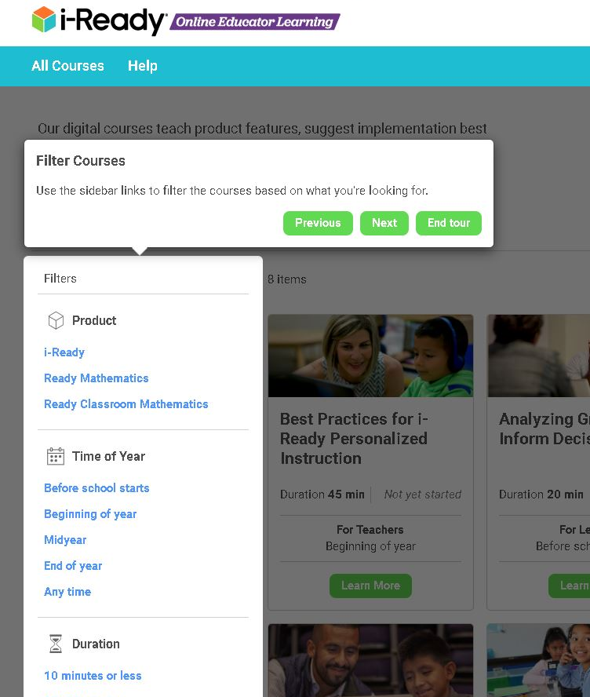
Take the tour!

Slide 9
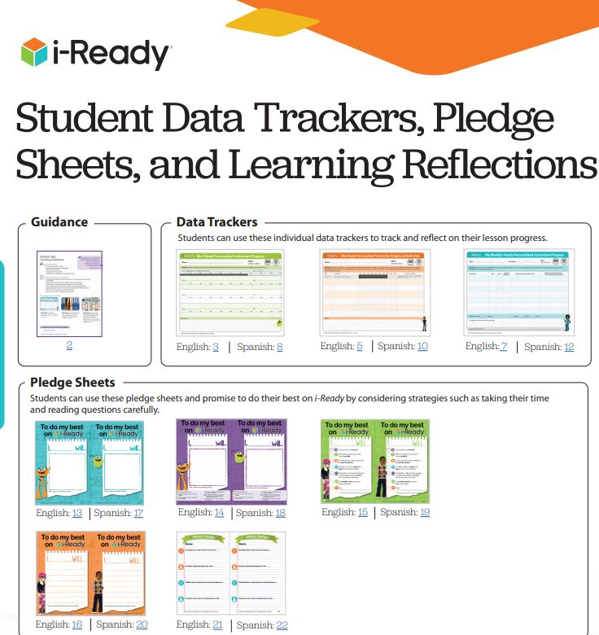
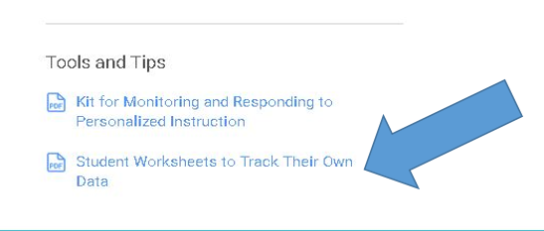

Slide 10
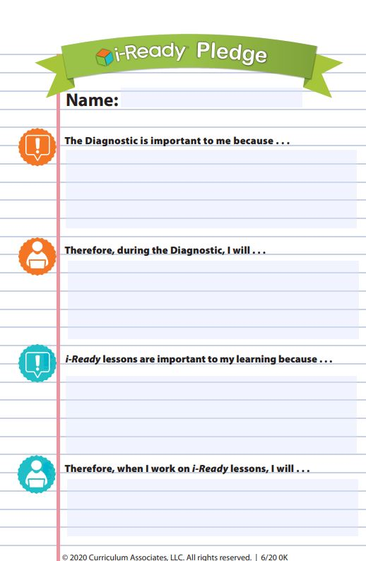
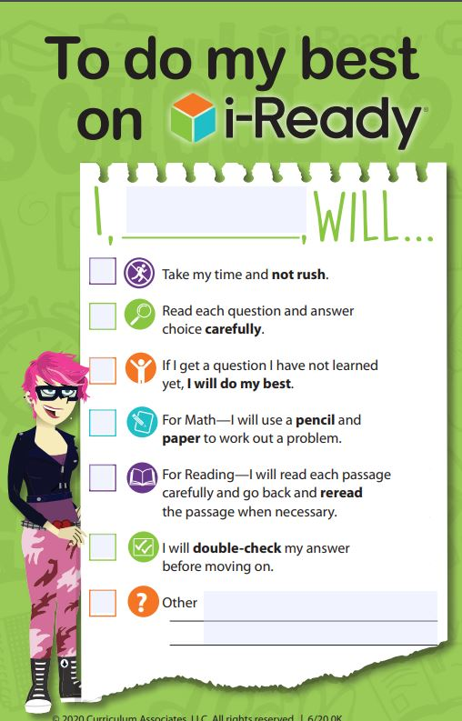
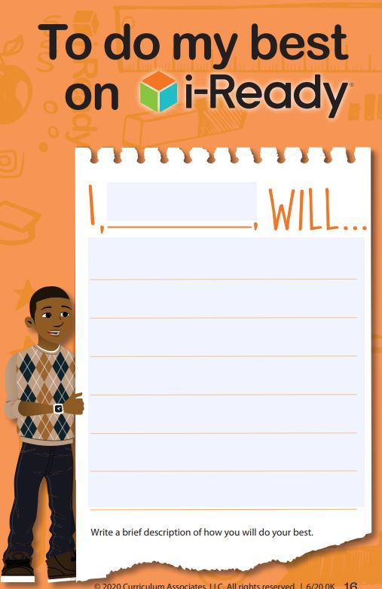

Slide 11
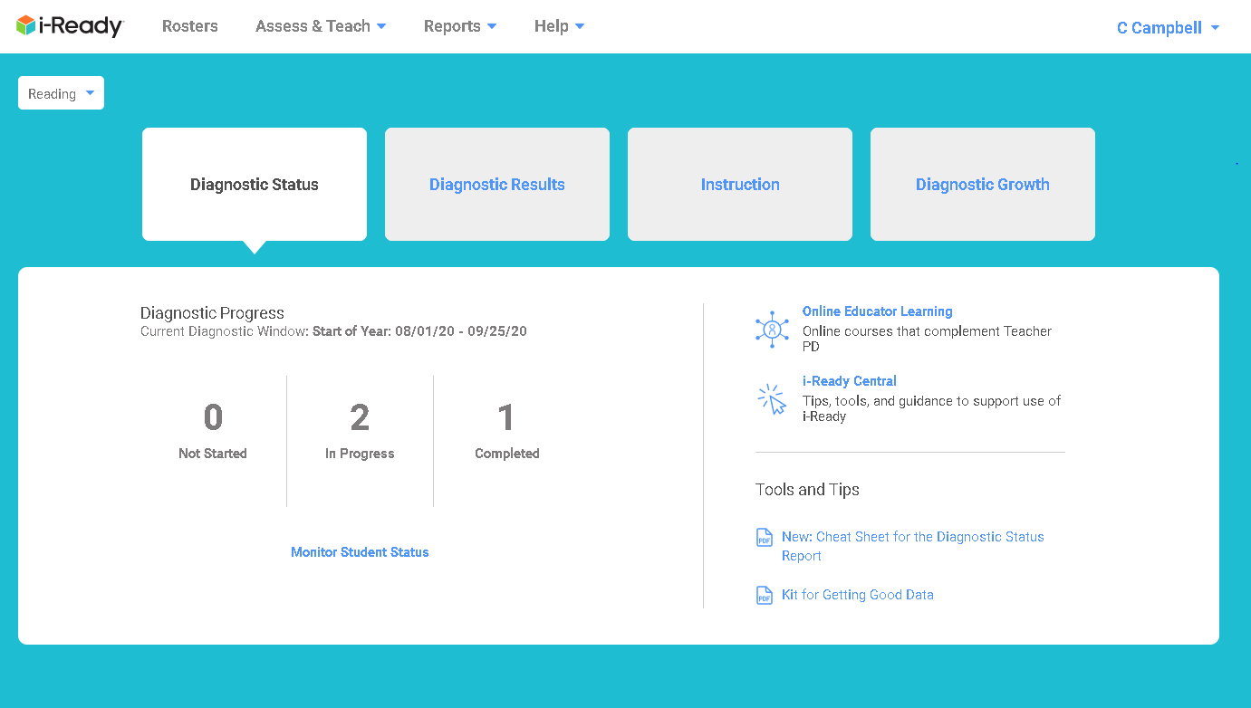
New Dashboard info for each section

Slide 12
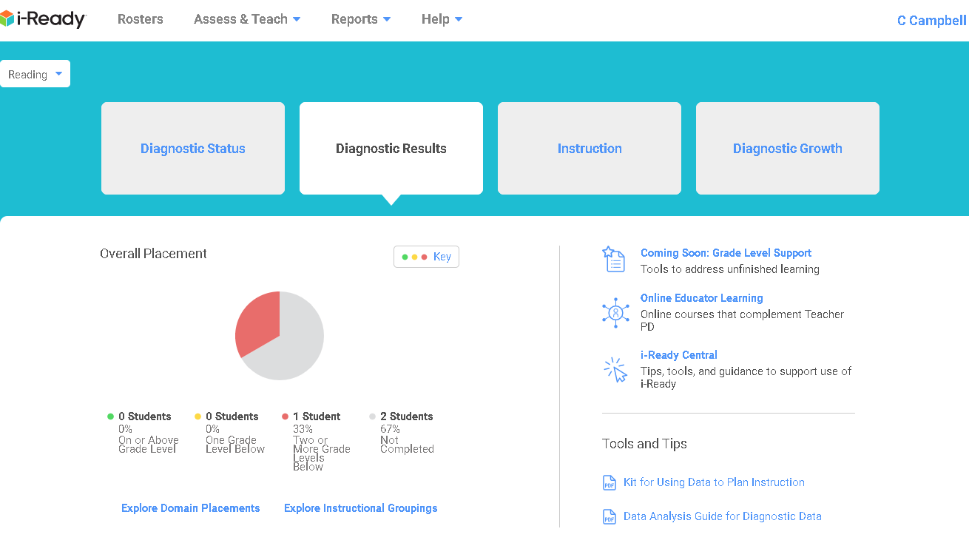

Slide 13
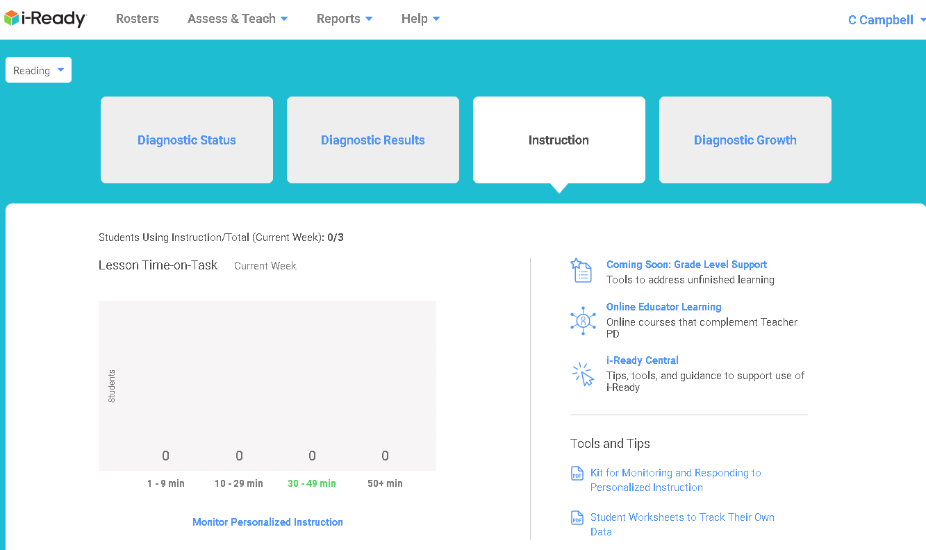

Slide 14
The Diagnostic
Encourage Good Testing Behavior
Read carefully
Take your time
Don’t get discouraged

Slide 15
The Diagnostic
Work with parents to make it a success.

Slide 16
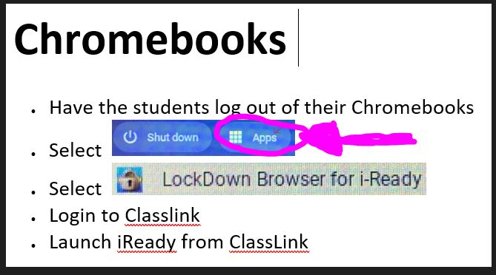
The Diagnostic
Students will use the LOCKDOWN BROWSER on the CHROME Device to take the Diagnostic!

Slide 18
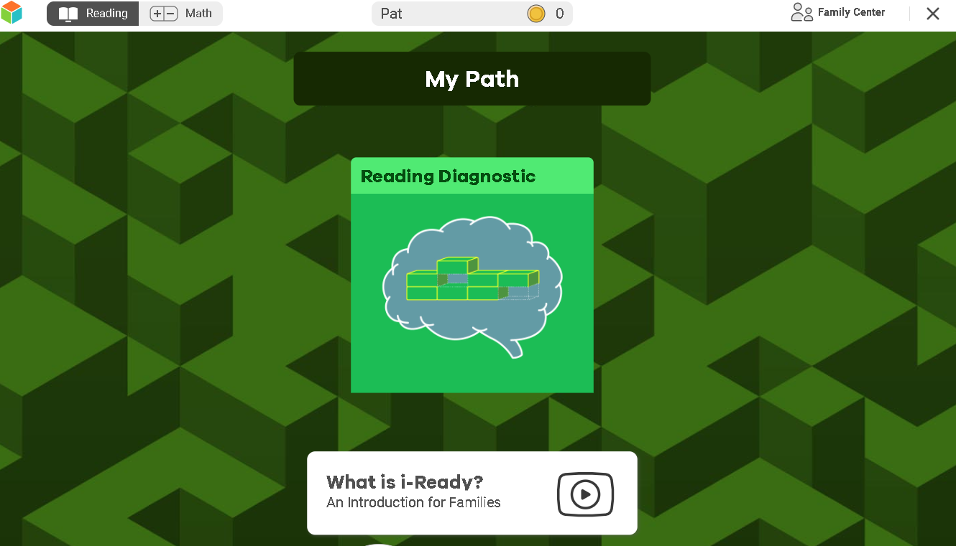

Slide 19
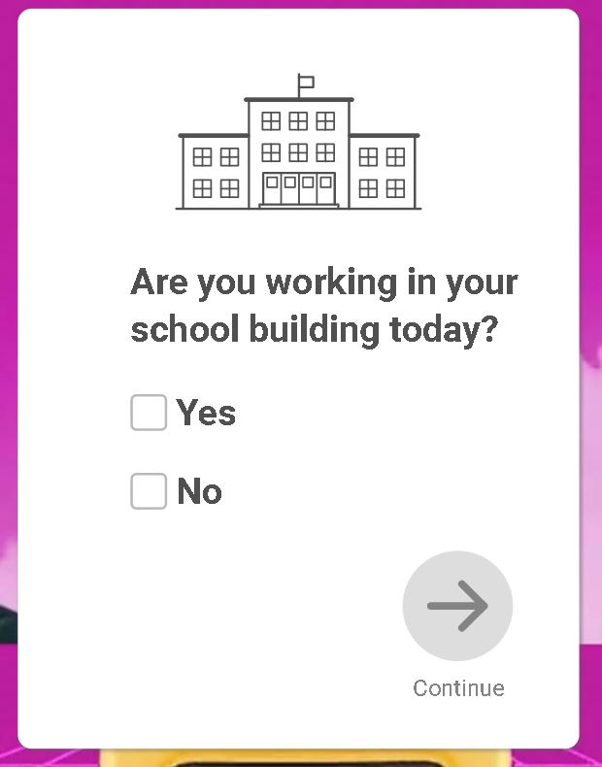
Choose YES and the student goes straight to the diagnostic.
Choose NO and the student goes to a Getting started Video.

Slide 21
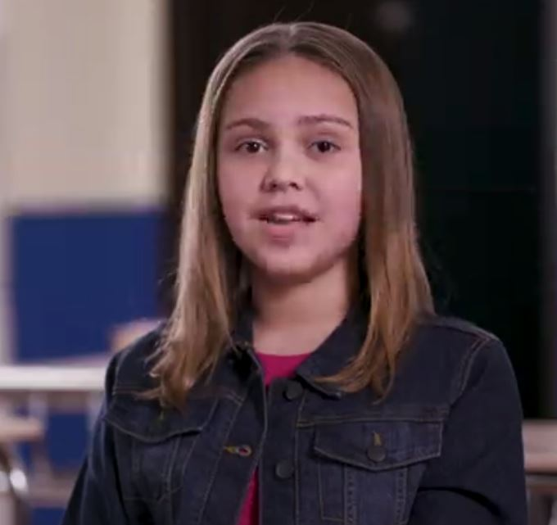
Your Video Hosts

Slide 22
Turn on captions
by clicking on the CC

Slide 24
Expect to answer only
½ the questions correctly!

Slide 25
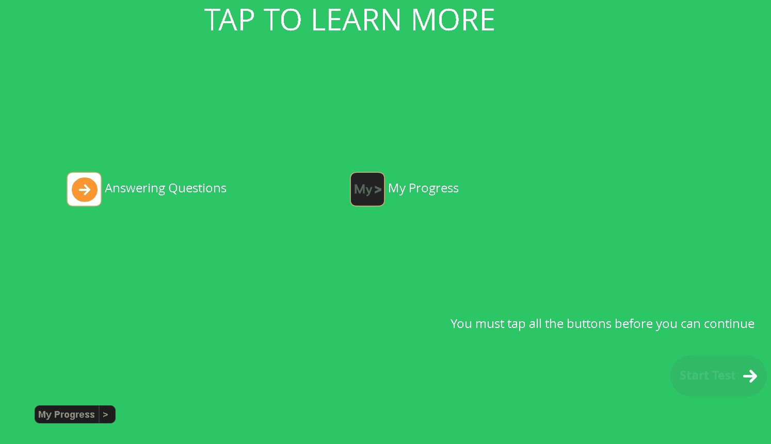
Students must click on all the buttons.
They may see more than two.

Slide 26
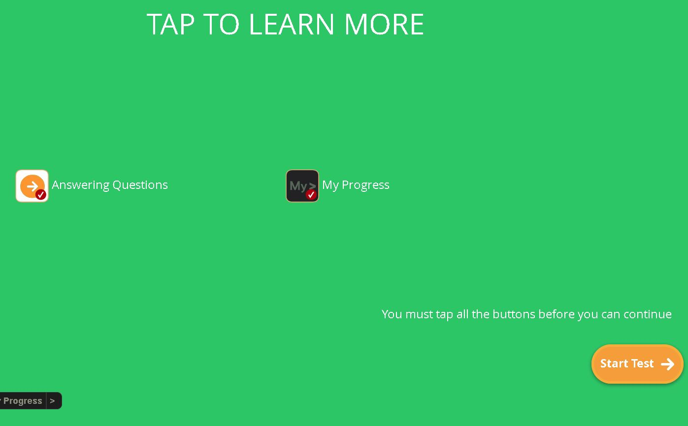

Slide 27
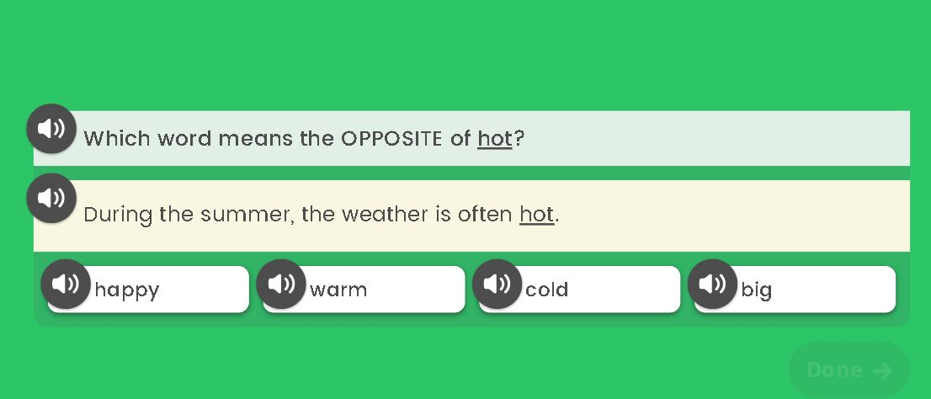
In early grades, the Read-Aloud feature begins at the start of the diagnostic.
In upper grades, the Read-Aloud feature starts when the student answers several questions incorrectly.

Slide 29
More tips during diagnostic

Slide 31
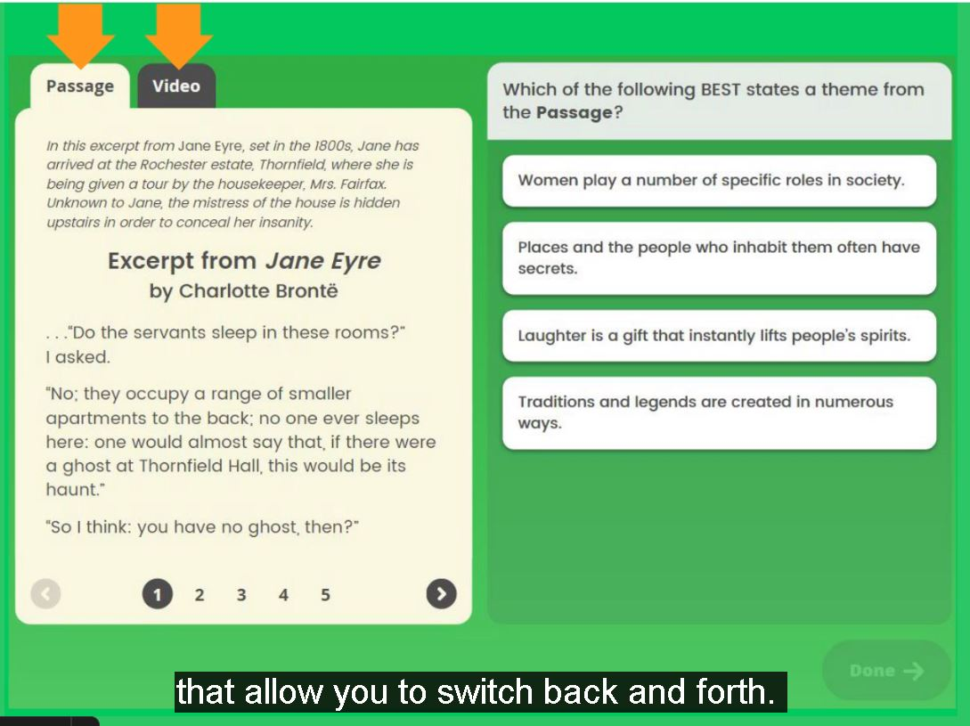

Slide 32
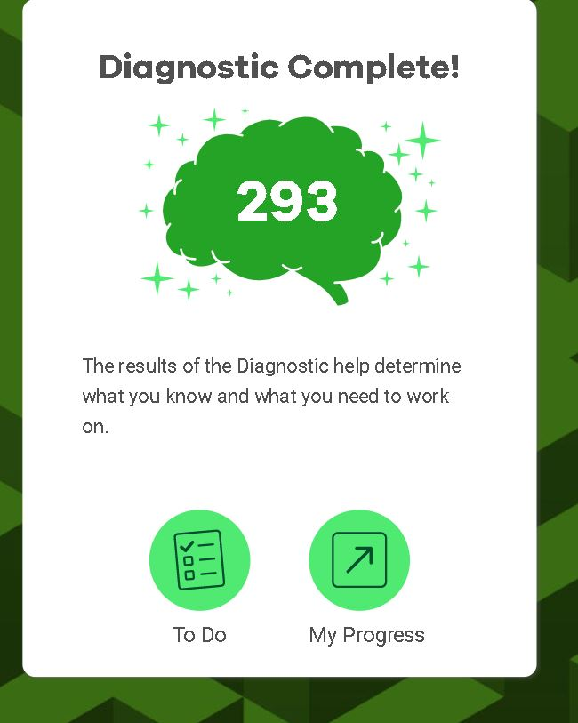
Remember:
Students do not have to finish diagnostic at one sitting!
It will start them where they left off!

Slide 33
Questions?

