Slide 1
School Improvement Mini-Conference Eureka Math-The Next STeps

Slide 2
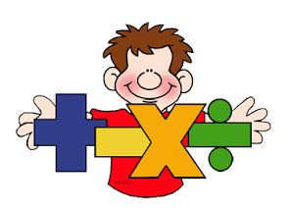
Before Eureka

Slide 3
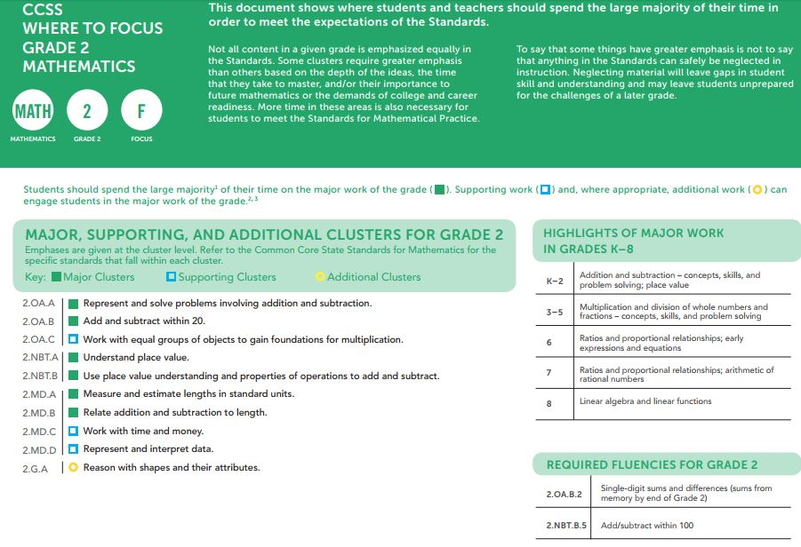
Standards Focus

Slide 4
Number Talks
Go to Embarc.online
Choose a grade level
Scroll Down for Number Talks
Introduction to Number Talks

Slide 5
Small Group Strategies
Student engagement and differentiated instruction
Manipulatives and Hands-On activities
Possible Small Group Structure
Group 1 – Direct instruction with teacher
Group 2 – Problem Set- assign “must do, can do, and impress me” problems
Group 3 – Independent Activity with
manipulatives (can come from
Application Problem or Concept
Development activities)
Group 4 - Zearn

Slide 6
Dreambox

Slide 7
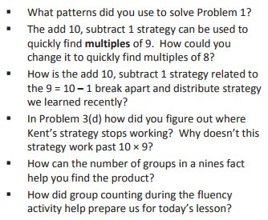
Debrief
Exit Tickets and Debriefings are NOT the same.
This is the opportunity to develop mathematical thinking. Use higher level thinking questions.

Slide 8
Pre-K Classrooms 30 Minute Block
10 Minutes - Whole Group Lesson
20 Minutes -Small Group Activities
Small group activities will come from any lesson in the TOPIC

Slide 9
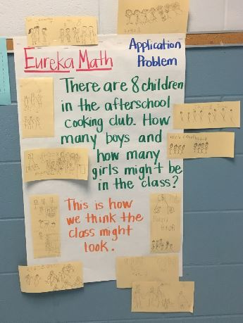
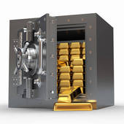
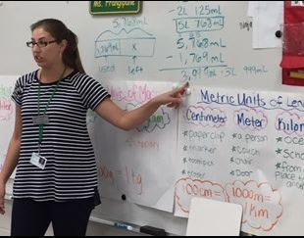
After Implementing Eureka The Vault

Slide 10
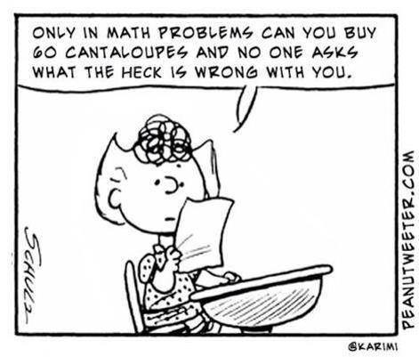
Questions?
Amy Beeler
Amy.beeler@sccpss.com
Phone – 912-438-2258

