Slide 1
End Of Year FAQs For Students and Families 2019-2020

Slide 2
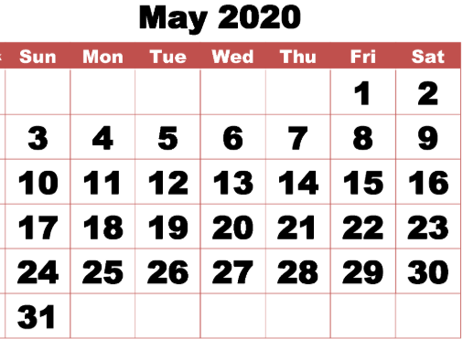
End of Year at a Glance
May 8, 2020
Last day for high school seniors
May 15, 2020
Final Date for Students to Submit Independent Learning Assignments
May 15, 2020
Last Day of School
May 22, 2020
Report Cards Posted Online
May 18-26, 2020
Post-Planning Week for staff

Slide 3
FAQs – School Items and Activities

Slide 4
FAQs – School Items and Activities
How will I return technology, books, uniforms, and needed items?
SCCPSS is considering a plan for end of year closeout. Additional details will be provided as they are available.
What is the best way to get updates related to school assignments and other information?
Visit the Savannah-Chatham County Public School District’s website to access the most current information and updates: www.sccpss.com. You may also check your school’s website for information related to remote learning activities and up-to-date information. Call or email your child’s teacher. If you are not receiving information and updates shared via phone, email or Powerschool, please send your current phone number and email address to your child’s teacher.
When is the last day of school for students?
For students in grades K-12, the final day of the year is May 15, 2020. Students in grades 9-12 will have an opportunity to attend summer school (priority will be provided to Class of 2020 and 2021 students). Summer school will not be offered in a traditional in-person environment. An online format will be provided.

Slide 5
FAQs – School Items and Activities
Will my student graduate if he/she has met state and district graduation requirements?
Yes, seniors who meet the state and district requirements for school year 2019-2020 will graduate.
How will the Savannah Chatham Public School System (SCCPSS) continue learning during school closure?
In order to support uninterrupted student learning, the District will provide home-based instruction through online assignments or printed materials. We refer to our online assignments “Independent Learning.”
How will the District ensure all students have access to instructional opportunities?
The District will use a combination of online and print materials. For families who do not have Internet access, printed materials will be provided.

Slide 6
Independent Learning

Slide 7
FAQs – Independent Learning
How does my child participate in Independent Learning activities if we do not have access to a device?
You can contact your teacher or school principal for guidance and use hard copies of the Independent Learning materials during this time. Additional packets are available at the Early Learning Center at Henderson E. Formey School from 7:30 a.m. until 2:30 p.m. Monday-Friday. Independent Learning Packet bins are replenished daily.
How does my child log on to receive his/her electronic assignments?
Teachers are given flexibility to use a variety of platforms to receive completed assignments or administer class assignments. These tools were commonly used prior to the COVID-19 closure and your child should be familiar with the appropriate online learning tools.
Are students expected to be online at a certain time, or by a certain time, or for a minimum amount of time in a day?
SCCPSS teachers will continue to deliver content to students virtually through a variety of digital tools and resources. Teachers will contact students via email, Class Dojo, Google Classroom, or Remind regarding any planned virtual meetings or lessons. It is recommended that your child stays engaged each day and works at his/her own pace.
When can my child receive support from his/her teacher?
Students can receive support during the online discussions, lecture, videoconferences, or during the teacher’s office hours via telephone. Teachers are also available to answer questions or provide additional support for students. Check your school’s website or email your child’s teacher for office hours.

Slide 8
FAQs – Independent Learning
What type of assignments should my child expect to receive?
Assignments will support instructional components specific to the subject material. Teachers will continue providing assignments to support learning through the end of the school year.
How will my child be graded during independent learning?
Student final grades will be based on the first three quarters of school. Work submitted during the fourth quarter will be used to demonstrate mastery of course standards for course completion and for improving existing grades. Fourth quarter performance will not have a negative impact on the third quarter average.
Will students have to take the End of Grade or End of Course Milestones Assessment this year?
No. On Monday, March 16, State School Superintendent Richard Woods announced a waiver of the state assessment window/administration (including Georgia Milestones EOGs and EOCs, the Georgia Alternative Assessment/GAA 2.0, and all other required testing, including End of Pathway Assessments and GKIDS). On March 20, U.S. Education Department approved Georgia’s statewide testing waiver. Georgia Milestones tests will not be administered this spring. There will be no administration of the Georgia Milestones testing this year. See more questions and answers about testing here: https://www.georgiainsights.com/testing.html.

Slide 9
Testing and Assessments

Slide 10
FAQs – Testing and Assessments
What about the 20% EOC course grade requirement?
At the State Board of Education meeting on March 26, State School Superintendent Richard Woods recommended a suspension of the 20 percent EOC course grade requirement. This recommendation was approved.
Will upcoming SAT and ACT administrations occur?
No. In response to the rapidly evolving situation around the novel coronavirus (COVID-19), College Board canceled the May 2 SAT administration. ACT has rescheduled its April 4 national test date to June 13 across the U.S. All students registered for the April 4 test date will receive an email from ACT informing them of the postponement and instructions for free rescheduling or a future national test date. SAT/ACT testing has been suspended for the remainder of the school year.
What are some of the ways teachers will continue to engage students through virtual learning?
Teachers will provide direct instruction via Google classrooms, virtual learning, weekly chats, and frequent telephone (see Independent Learning section) conferences.
Will Georgia colleges and universities require SAT and ACT scores for admissions?
The University System of Georgia will be waiving SAT/ACT entrance requirements for admissions.

Slide 11
FAQs – Testing and Assessments
What will happen with Advanced Placement (AP) exams this school year?
College Board is offering AP exams virtually. This year’s AP exams will not include questions from the final units of the course – units typically covered in March and April. In addition, the streamlined exams will take no longer and can be completed on a mobile phone. By April 3, College Board will publish the full exam schedule, including the specific free-response question types that will comprise each AP exam. Keep in mind, the exams will be “open book.” Any student already registered for an exam can choose to cancel at no charge.
What about International Baccalaureate (IB) testing?
May 2020 examinations for Diploma Programme and Career-Related Programme students will no longer be held. Depending on the student’s exam schedule, the student will be awarded a Diploma or a Course Certificate that reflects their standard of work. This is based on the student’s coursework and the established assessment expertise, rigor and quality control already built into the respective program.
Will students have to take the Georgia Alternate Assessment (GAA) this year?
On March 16, State School Superintendent Richard Woods suspended the state assessment window/administration (including the Georgia Alternate Assessment/GAA 2.0). On March 20, the U.S. Education Department approved Georgia's statewide testing waiver. Georgia Alternative Assessment (GAA) 2.0 testing will not take place this school year.

Slide 12
Student Services

Slide 13
FAQs – Student Services
Will SCCPSS count attendance?
Students will not be negatively impacted by attendance. All students will be considered present during the 4th Quarter of the 2019-2020 school year.
Will students be required to take End-of-Pathway Assessments (EOPA) for Career, Technical and Agricultural Education (CTAE) classes?
No. On March 16, State School Superintendent Richard Woods suspended the state assessment window/administration (including End of Pathway Assessments).
With the exceptional circumstances created by COVID-19, is the Savannah Chatham County Public School System (SCCPSS) required to provide a student with the educational and related services needed for the implementation of the student’s Individualized Education Plan (IEP)?
Yes! Regardless the exceptional circumstances created by COVID-19, SCCPSS is still required to make a good faith effort to provide the educational and related services to the greatest extent possible needed for the implementation of a student’s IEP. The educational and related services may be provided virtually, online or telephonically. Our staff are still available and ready to assist. Please contact your child’s teacher if you have any questions or need additional assistance.

Slide 14
Grading and Promotion

Slide 15
FAQs – Grading and Promotion
Will SCCPSS offer summer school?
All students in grades K-8 will have the opportunity to engage in Intercession for remediation May 4 to May 15. Intercession will include virtual learning opportunities or Independent Learning Packet lessons that will be offered to students not passing at the end of the third quarter. High schools will offer digital learning options through summer school with a focus on students of the 2020 and 2021 graduating classes.
How is SCCPSS handling grading during this time frame?
Assignments submitted during the fourth quarter will be used to enhance, enrich, or remediate. Work submitted during the fourth quarter will be used to demonstrate mastery of course standards for course completion and for improving existing grades.
How will SCCPSS handle promotion of students to the next grade level?
The District has student grades from three-quarters of the school year recorded for promotion and retention consideration and based on actions that align with guidance from the Georgia Department of Education, student work during the final quarter of the year will be used toward the enhancement of existing grades, remediation, enrichment, or demonstration of mastery on course standards. All other criteria required for consideration in making promotion and retention decisions shall be suspended for the 2019-2020 school year.

Slide 16
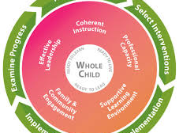
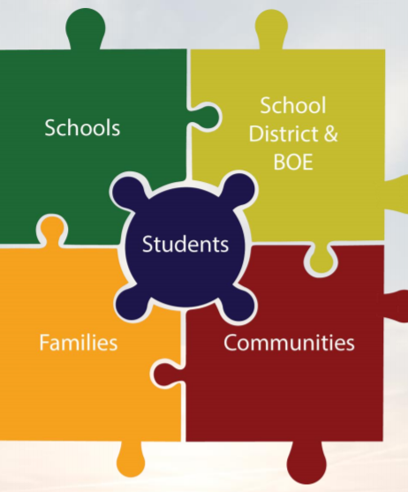
Student Support Services

Slide 17
FAQs – Student Support Services
What resources are available to help Migrant Education and Immigrant Families?
Tutoring and Interpreting Services are available. Please contact Dr. Andrea Deshazo by calling 912-395-5877 or by email andrea.deshazo@sccpss.com.
How can parents set up a parent-teacher conference with their child's teacher during school closures?
Parents can contact the Title I Family Engagement Program to assist them with setting up a virtual parent-teacher conference during school closures. Parents can also contact their child’s teacher directly by telephone or email to schedule conferences.

Slide 18
FAQs – Student Support Services
What resources are available for families experiencing homelessness?
Parents can contact the District’s Homeless Liaison, Ms. Sharon Hill, at (912) 395-5635 or by email at Sharon.hill@sccpss.com to assist families in need.
How can parents complete enrollment for students new to the District?
Parents can complete our online registration form to enroll new students at: https://secure.infosnap.com/family/Login?ReturnUrl=http%3A%2F%2Fsecure.infosnap.com%2Ffamily%2Fdirectaction&AutoLogOut=False
How can parents complete registration requirements for current SCCPSS students?
SCCPSS students will remain enrolled in their current school of attendance with the current teacher(s) of record. There will be no internal transfers to another site for the remainder of the 2019-2020 school year.
Is the deadline being extended for parents to apply for a general administrative transfer to another SCCPSS school for SY2020-21?
The administrative placement window is scheduled during from June 19^{th -} June 22nd. Parents will need to check the district’s website periodically for updates.

