Slide 1
CGCA Geography bee
November 29th, 2017 Grand prize = $25 Gift Card

Slide 2
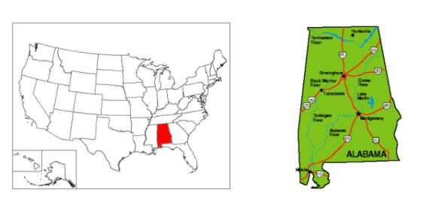
Montgomery, Alabama

Slide 3
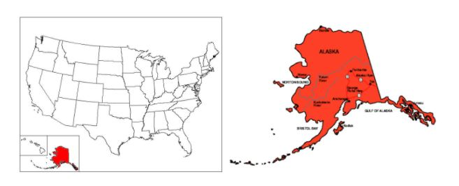
Juneau, Alaska

Slide 4
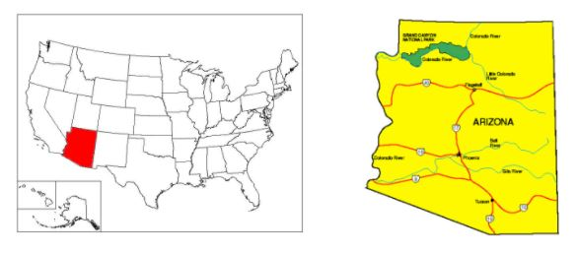
Phoenix, Arizona

Slide 5
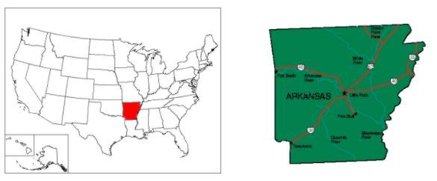
Little Rock, Arkansas

Slide 6
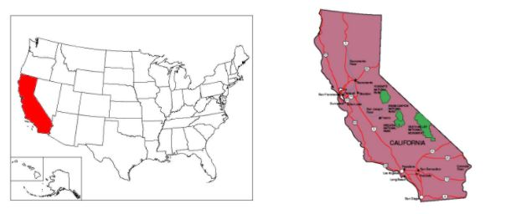
Sacramento, California

Slide 7
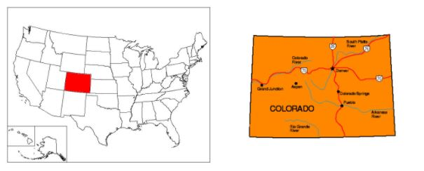
Denver, Colorado

Slide 8
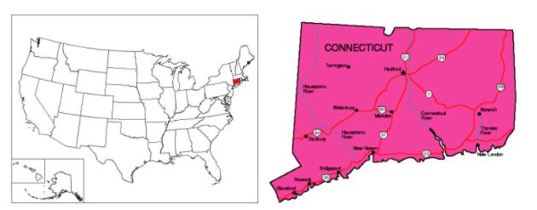
Hartford, Connecticut

Slide 9
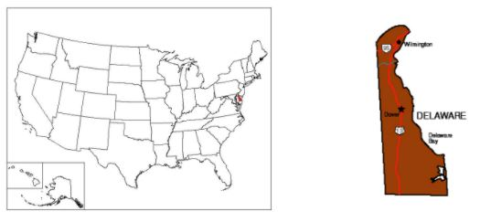
Dover, Delaware

Slide 10
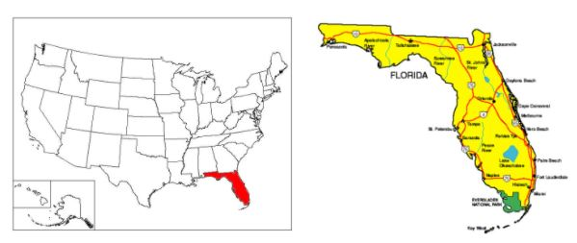
Tallahassee, Florida

Slide 11
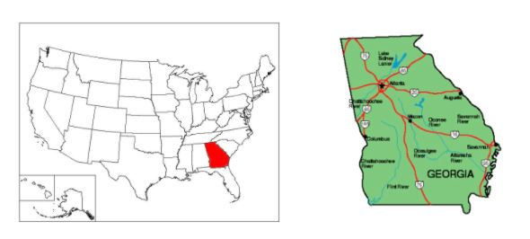
Atlanta, Georgia

Slide 12
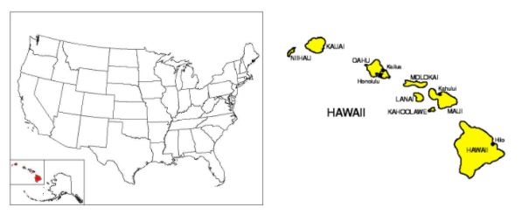
Honolulu, Hawaii

Slide 13
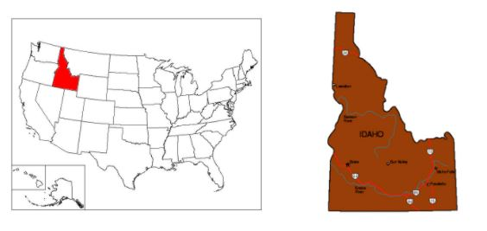
Boise, Idaho

Slide 14
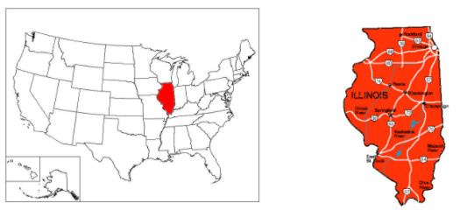
Springfield, Illinois

Slide 15
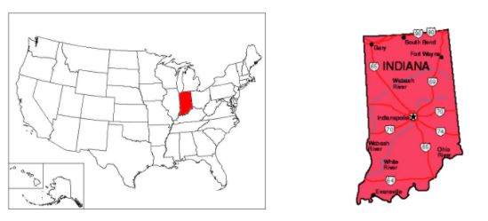
Indianapolis, Indiana

Slide 16
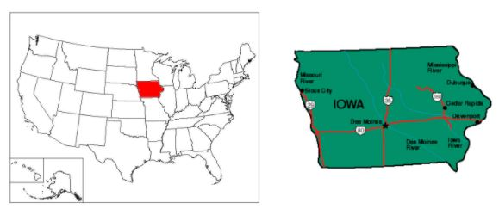
Des Moines, Iowa

Slide 17
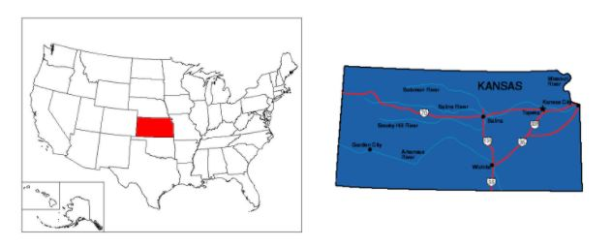
Topeka, Kansas

Slide 18
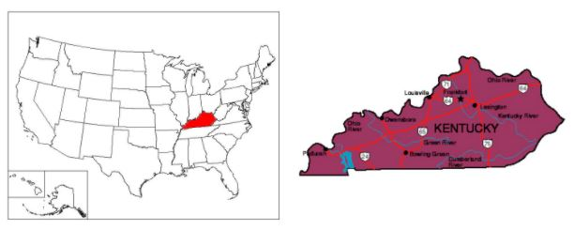
Frankfort, Kentucky

Slide 19
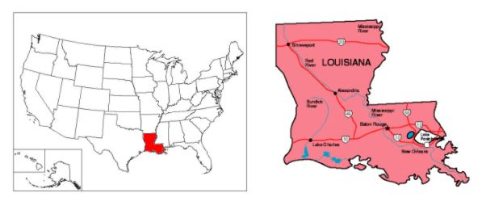
Baton Rouge, Louisiana

Slide 20
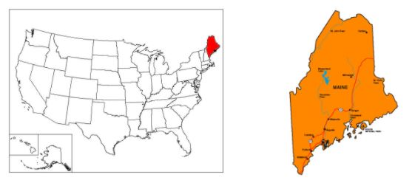
Augusta, Maine

Slide 21
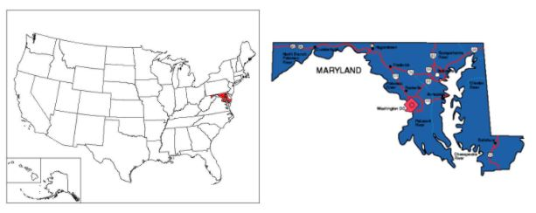
Annapolis, Maryland

Slide 22
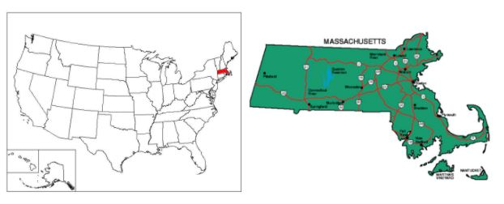
Boston, Massachusetts

Slide 23
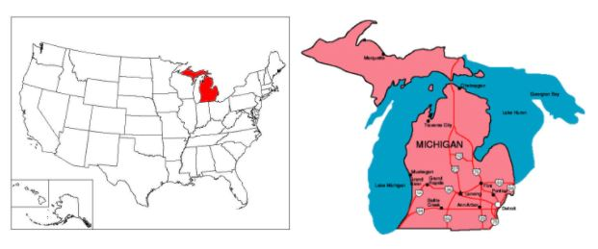
Lansing, Michigan

Slide 24
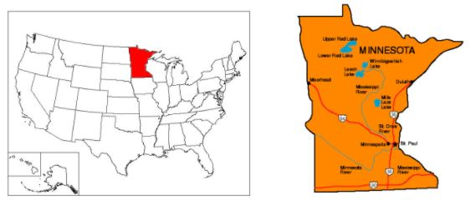
St. Paul, Minnesota

Slide 25
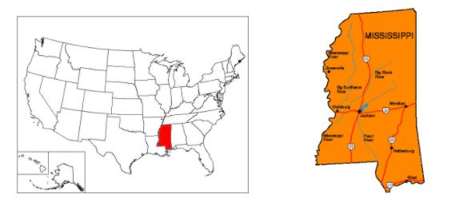
Jackson, Mississippi

Slide 26
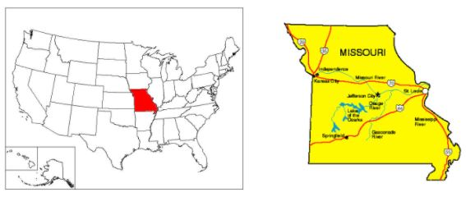
Jefferson City, Missouri

Slide 27
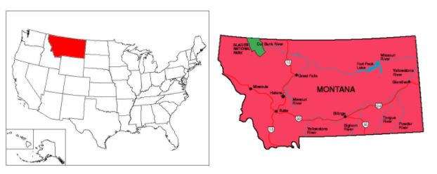
Helena, Montana

Slide 28
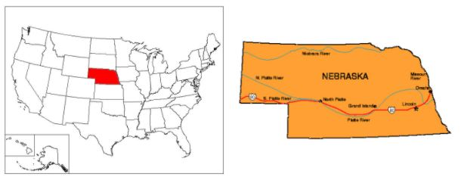
Lincoln, Nebraska

Slide 29
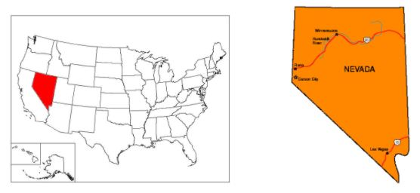
Carson City, Nevada

Slide 30
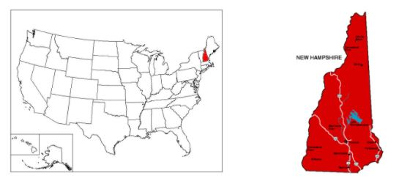
Concord, New Hampshire

Slide 31
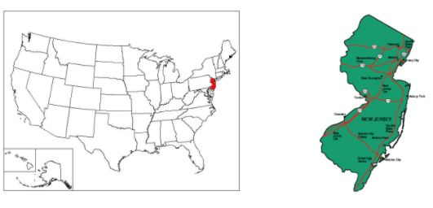
Trenton, New Jersey

Slide 32
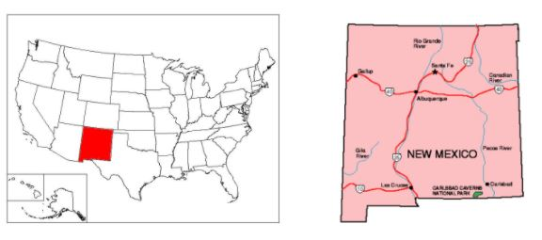
Santa Fe, New Mexico

Slide 33
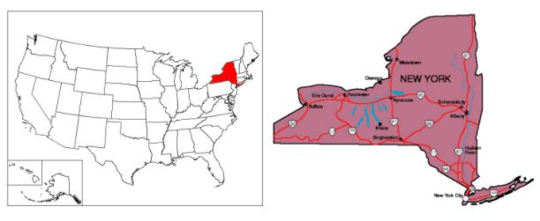
Albany, New York

Slide 34
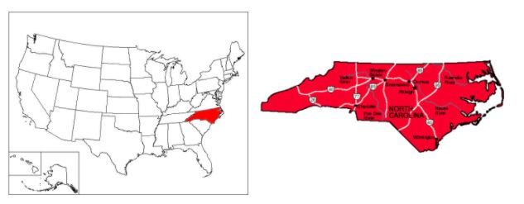
Raleigh, North Carolina

Slide 35
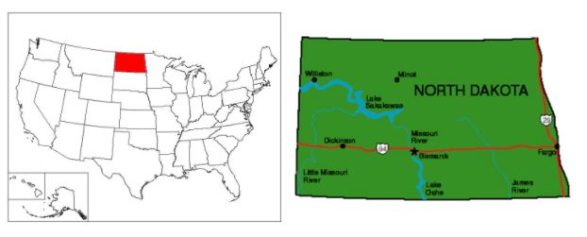
Bismarck, North Dakota

Slide 36
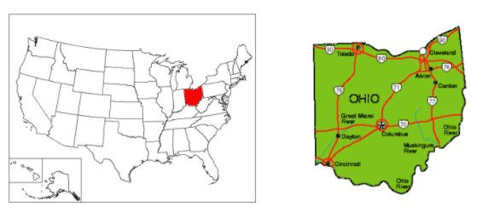
Columbus, Ohio

Slide 37
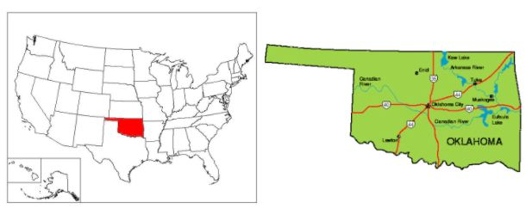
Oklahoma City, Oklahoma

Slide 38
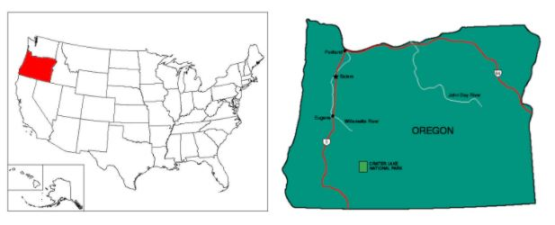
Salem, Oregon

Slide 39
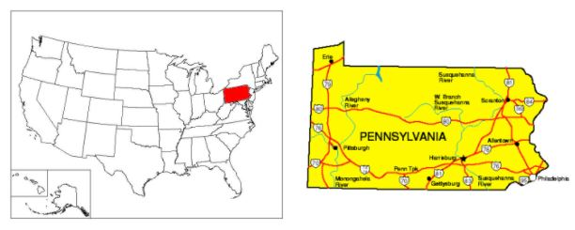
Harrisburg, Pennsylvania

Slide 40
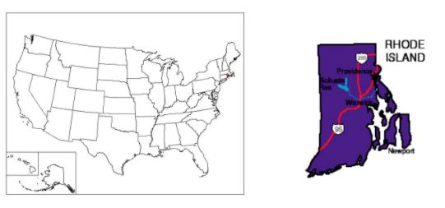
Providence, Rhode Island

Slide 41
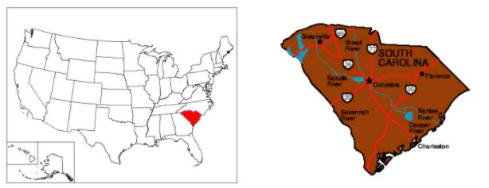
Columbia, South Carolina

Slide 42
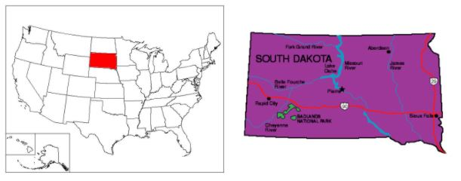
Pierre, South Dakota

Slide 43
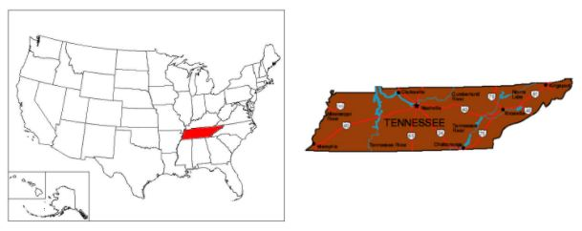
Nashville, Tennessee

Slide 44
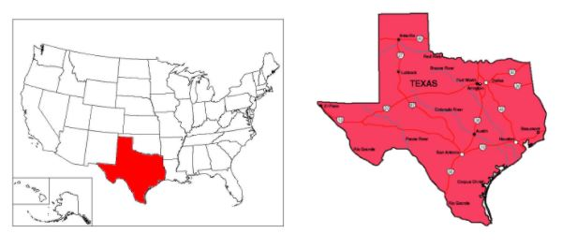
Austin, Texas

Slide 45
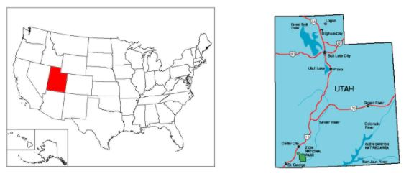
Salt Lake City, Utah

Slide 46
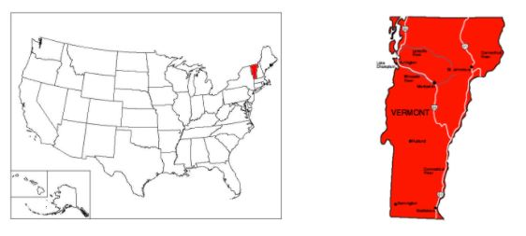
Montpelier, Vermont

Slide 47
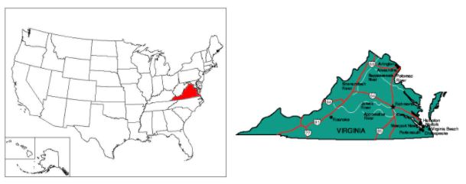
Richmond, Virginia

Slide 48
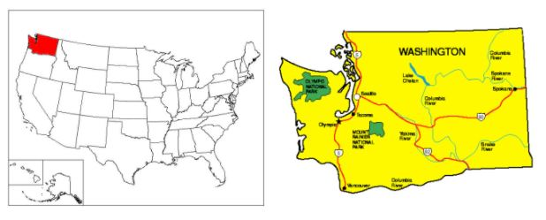
Olympia, Washington

Slide 49
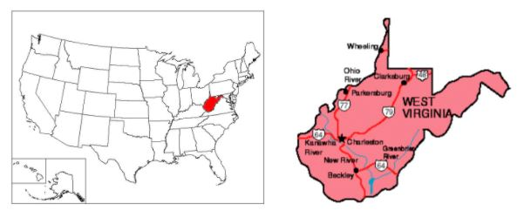
Charleston, West Virginia

Slide 50
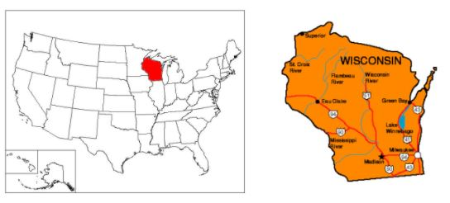
Madison, Wisconsin

Slide 51
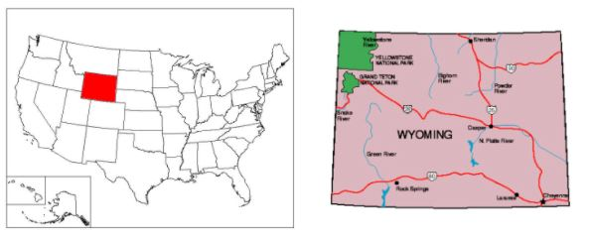
Cheyenne, Wyoming

