Slide 1
A Structured PBIS Classroom for Emotional Behavioral Disordered Students
Leslie Westmoreland
Cynthia Campbell
Coastal Georgia Comprehensive Academy
Savannah, Georgia

Slide 2
Learning Outcomes
Increase knowledge of basic practices that help students with Emotional Behavioral Disorders experience success in the classroom.
Learn about successful PBIS practices in a classroom for students with Emotional Behavioral Disorders.
Gain ideas to improve behavior management in your classroom setting.

Slide 3
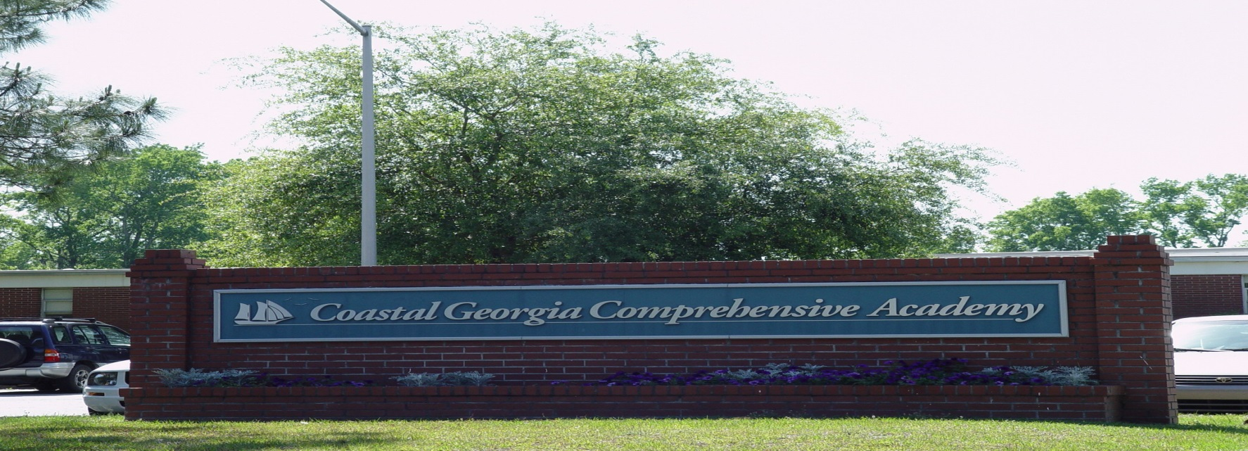
GNETS Program serving students from Chatham and Effingham County
Students exhibit severe emotional behavioral disorders or severe autism with associated behaviors
Notes:
How we get students

Slide 4

Focus of Program
Behavioral Skills
Communication Skills
Socialization Skills
Academics
Notes:
Talk about success in returning to school increased if we have made academic success
But that is not possible without success in the other areas
Success needs to be internalized – not just due to the teachers strength and crisma

Slide 5

Core Beliefs
All children can be successful.
All children can learn.
All children want to have positive experiences.
All children need a safe place to learn and practice new skills.

Slide 6

Organization of Classroom:
How to Structure Physical Environment
Placement of Furniture
Control of Materials
Location of Teacher’s Desk
Organization of Room to Limit Distractions

Slide 7
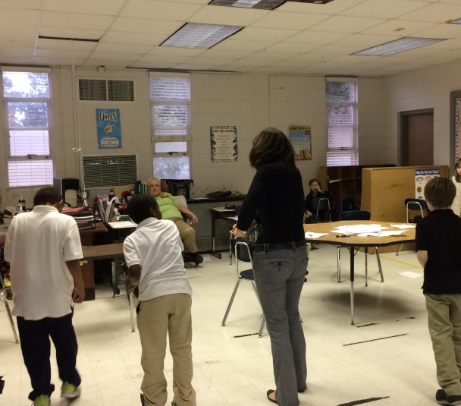
Organization of
Classroom:
Schedule
Activity length based on students ability and developmental level
Breaks built into the day
Group time to teach social skills
Motivating activities following work periods
Movement incorporated into schedules
Consistency of schedule

Slide 8
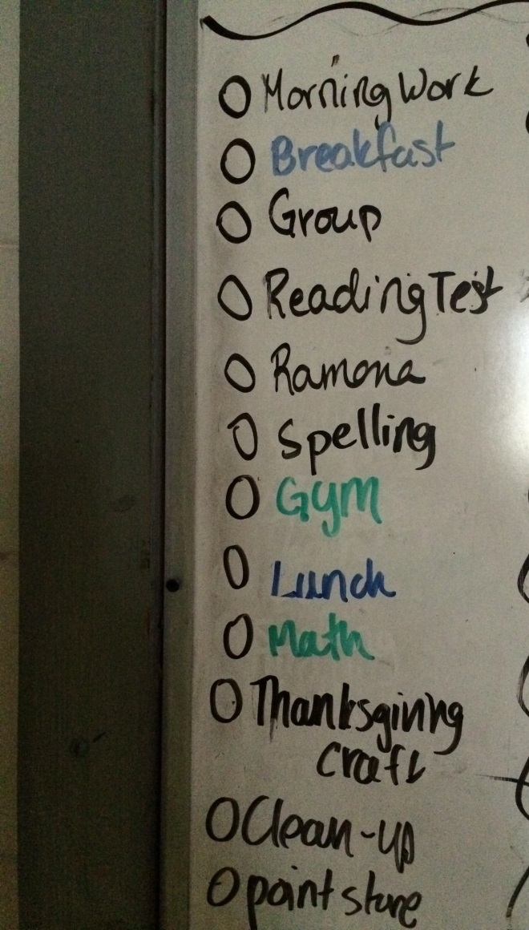
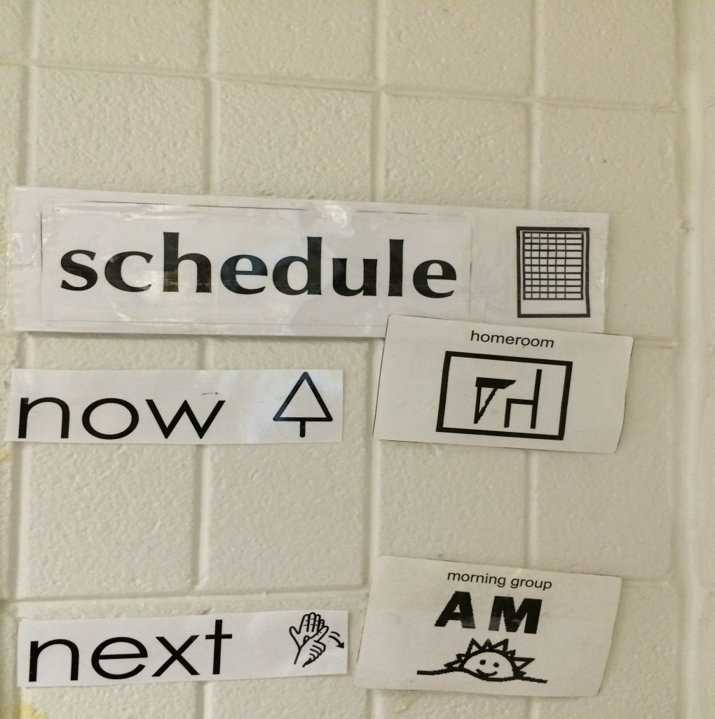
Schedules

Slide 9
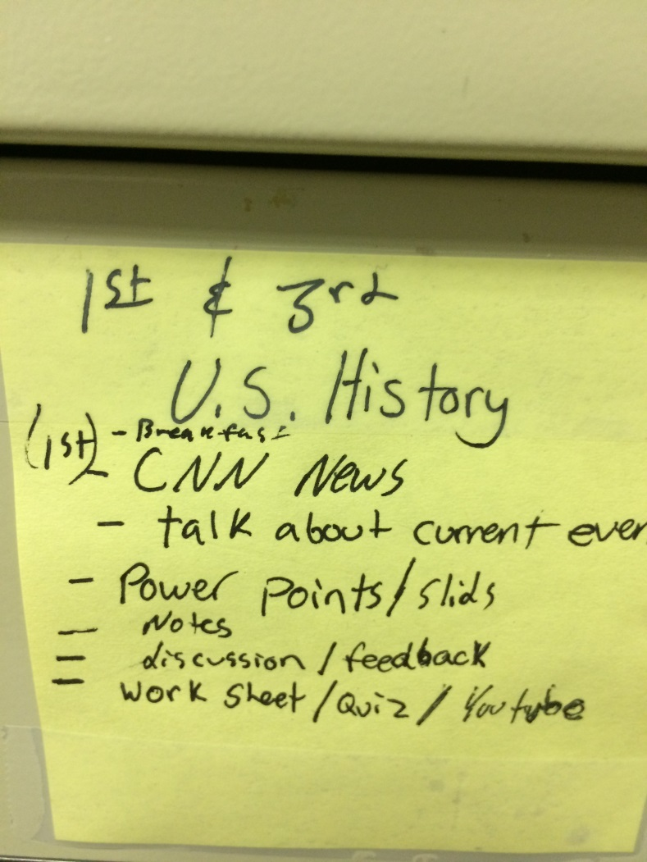
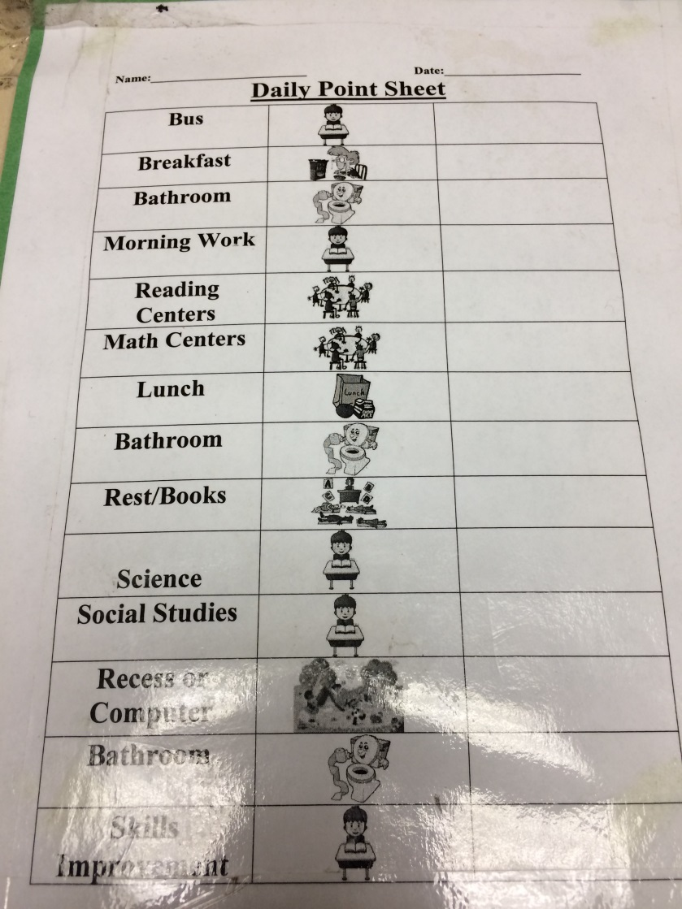
Schedules

Slide 10

Teacher Roles
Build appropriate relationships with the students
Clear roles: Who is in charge of what
Communication: among staff and staff with students
    Voice tone
    Body language
    Show interest and avoid sarcasm

Slide 11

Surface Management Techniques

Slide 12
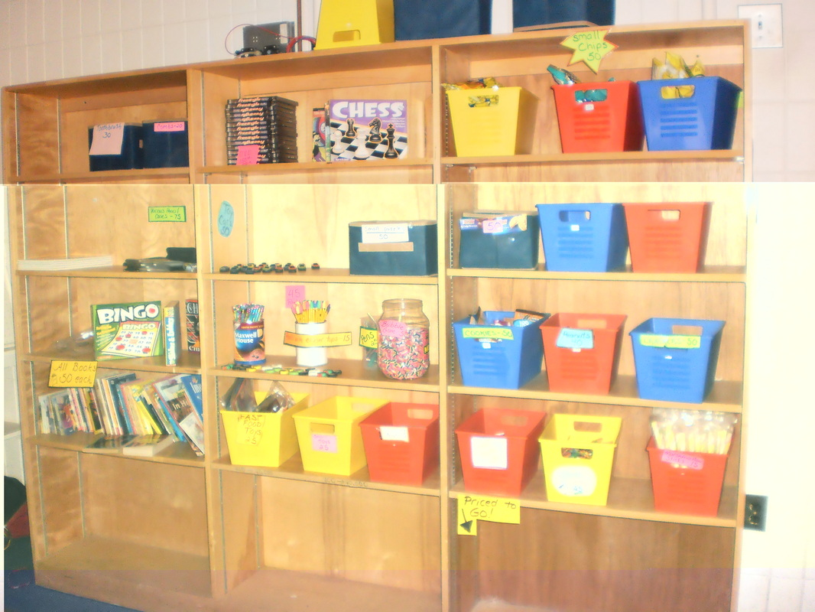
Consequences
Students earn positive points
Rules and expectations are clear
  Students earn - teachers don’t award
Rewards built into day
  Free time
  Recess
  Centers
  Point store

Slide 13
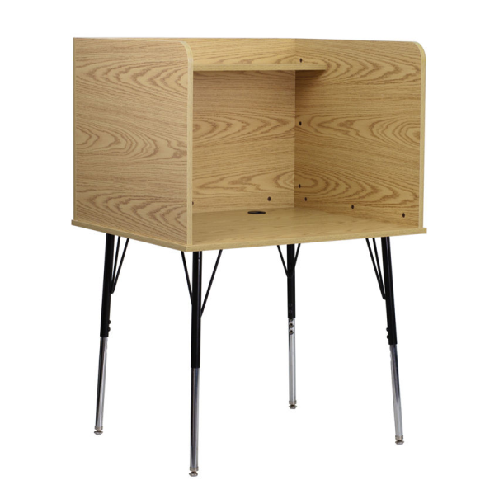
Consequences Continued
There are set consequences for inappropriate behavior
  Time away from classroom
  Intensive Intervention Room
  Positive return of students to classroom

Slide 14

Data
Changes to treatment program made during treatment meetings after review of the data. Not made in the heat of the moment
Data Sources
  Discipline referrals
  Point Sheets and debriefing notes
  SWISS
  Notes from intensive interventions and therapy room sessions
  Developmental Therapy Rating Forms
  Family information / Psychological Testing

Slide 15
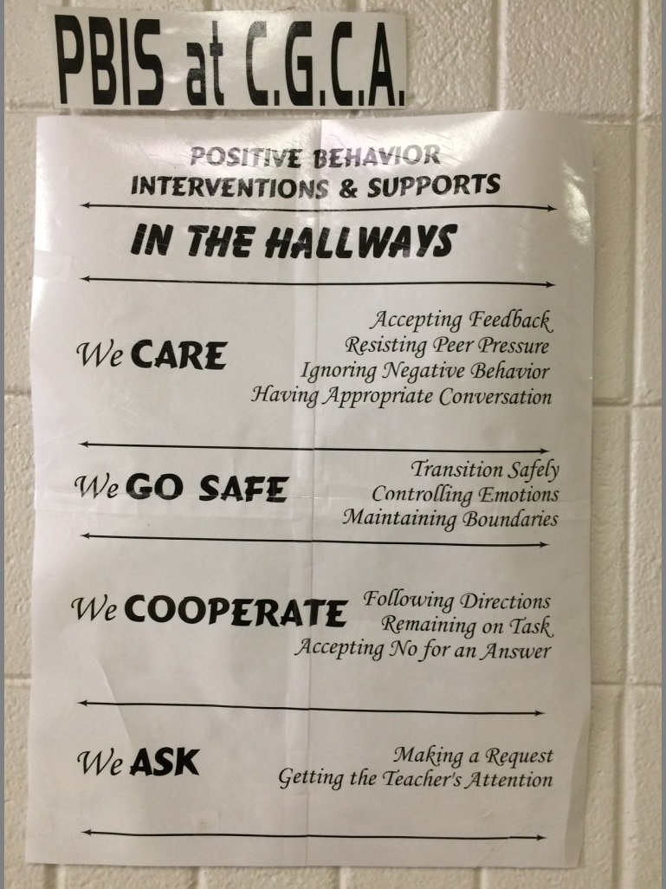
Coastal Georgia Comprehensive Academy PBIS System

Slide 16
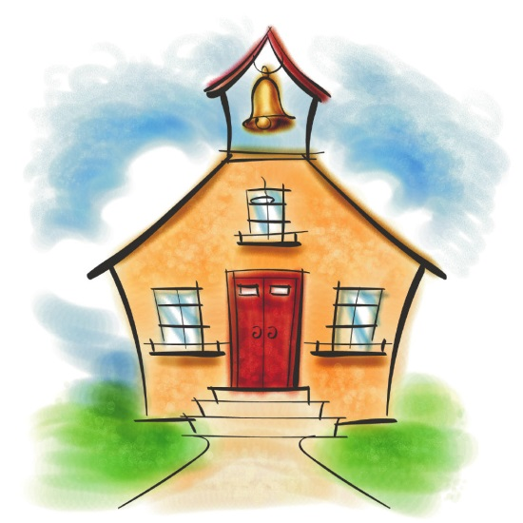
End of Session Thoughts
Questions
Think of one practice or idea that you gained during this session that might help you back at your school.

